Slide 1
NUSA ‘Class of 2020’

Slide 2
Key Areas
The new GCSE’s grading system
What is the current picture of your child’s achievement?
Making ‘Every Lesson’ count
High impact ‘Independent Study’- Knowledge Organisers
Preparation for Assessments & Extended Study
GCSE English & GCSE Maths
Maximising progress- supporting your child
Careers Guidance
CLASS of 2020

Slide 3
The government’s definition of a ‘good pass’ is set at grade 5 for reformed GCSEs.

Slide 4
New GCSE
Old GCSE
Higher
9
8
Higher
7
A*
Foundation
A
6
Foundation
5
5
B
4
4
C
C
3
D
D
0
2
E
E
U
F
1
0
G
U
Notes:
Harder overall and the “good pass” bar has been raised.
Less crossover between H and F – less of a safety net below 5 on Higher. Inevitably more pupils will sit Foundation to target 5.
The decision on what paper to sit will be taken later based on mock exam results – the mocks are so important for this reason.

Slide 5
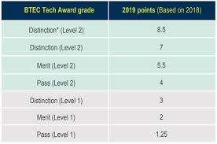
Notes:
This is an overview of the Btec Qualifications framework
To get onto level 3 courses students will need to Achieve a Level 2 merit

Slide 6
What is the current picture of your child’s achievement?
Where are they now and where should they be?
Please look at your child’s 11.2 report
Your child should be aiming to meet or exceed their ‘Minimum Expected Grade’ to avoid being a concern
The ‘Predicted Grade’ shows you if your child is likely to meet their ‘Target Grade’ based on their current effort and attitude to work

Slide 7
The Power of a ‘Brown’ envelope
Notes:
This is what they will receive when the day arrives in the summer
Quite a powerful envelope as it decides what they will do for the next 2 years and beyond

Slide 8
What do you want to achieve?
If you want to study a Level 3 vocational course or apprenticeship you will need 5 GCSE’s 9-4 grading, this can include 2 BTEC’s and must include English & Maths
If you want to study A Levels at College you need a grade 5 in English and Maths
You need a grade 5+ (sometimes 6s and 7s) in the subjects you want to study

Slide 9
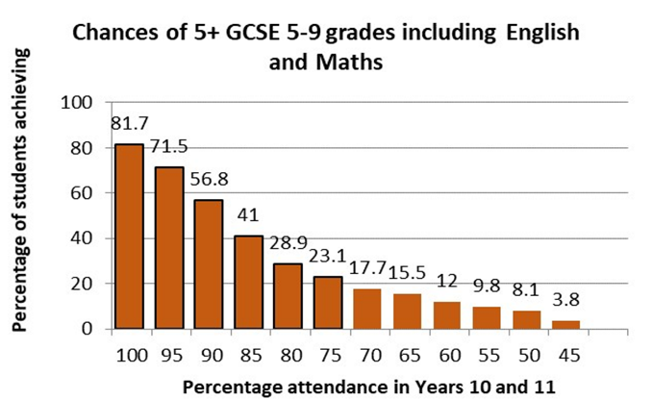

Slide 10
10000 hours of practice to achieve ‘MASTERY’/ PuRPOSE
Malcom Gladwell explains that reaching the 10,000-Hour Rule, which he considers the key to success in any field, is simply a matter of practicing a specific task that can be accomplished with 20 hours of work a week for 10 years
Or, if we take 15 years and give ourselves 4 weeks a year holiday it would equate to 14 hours a week.
Lets say 2 days off a week this theory would equate to approximately 2 hours and 45 minutes a day of practice
This theory is relevant especially to those of you trying to achieve ‘mastery’ in; sports, arts, music or attempting to become a contestant on ‘Mastermind’
This requires: determination, resolve, firmness (of purpose), steadfastness, backbone, drive, push, enthusiasm, ambition, enterprise, motivation, single-mindedness, commitment, conviction, dedication

Slide 11
Modern day ‘pursuits of mastery’
Social media
Facebook
Twitter
Instagram
Snapchat
☹
Xbox/
PlayStation
‘Fortnight’
☹
Our table-tennis setup in the ‘Street’ and some notable basketball addicts are a good example of how dedicated and engaged students can be
☹ ☺
Art Clubs
&
PE clubs
☺
Our ‘Achievement Hub’ ‘Intervention’ sessions and ‘Masterclasses’ are used well by a number of students
☺
Taeja James trains 5/6 times a week in Birmingham, often before school
How many of you can engage in meaningful ‘Pursuits of Mastery’ ???

Slide 12
Revising for Maths
Maths is a practical subject
The best way for students to revise for their maths GCSE is by doing maths. The more they practise, the more progress they will make
We cannot revise maths by reading content

Slide 13
What is your favourite maths topic?
Independent Study– is it worth the hassle?
The short answer is YES!
Research has shown that regular completion of independent study at secondary level can add on an additional 5 months progress onto a child’s learning’
It is a chance to practise, consolidate and stretch the learning independently
Where students complete regular independent study the average marks improvement can be as high as 50 marks which leads to an average grade improvement of 2 full grades

Slide 14
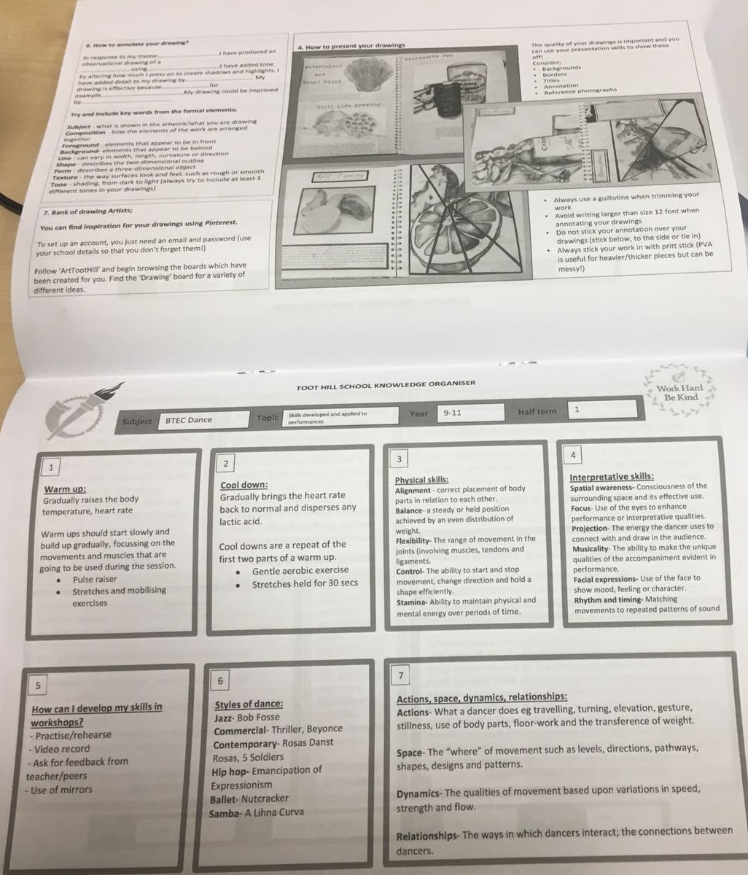
Independent Study and Knowledge organisers
Notes:
independent study

Slide 15
Slow progress…
Notes:
Active engagement rather than passive compliance, really important your child engages in the lesson. Please contact the class teachers if you want regular updates about their involvement and continue to check Kickboard.

Slide 16
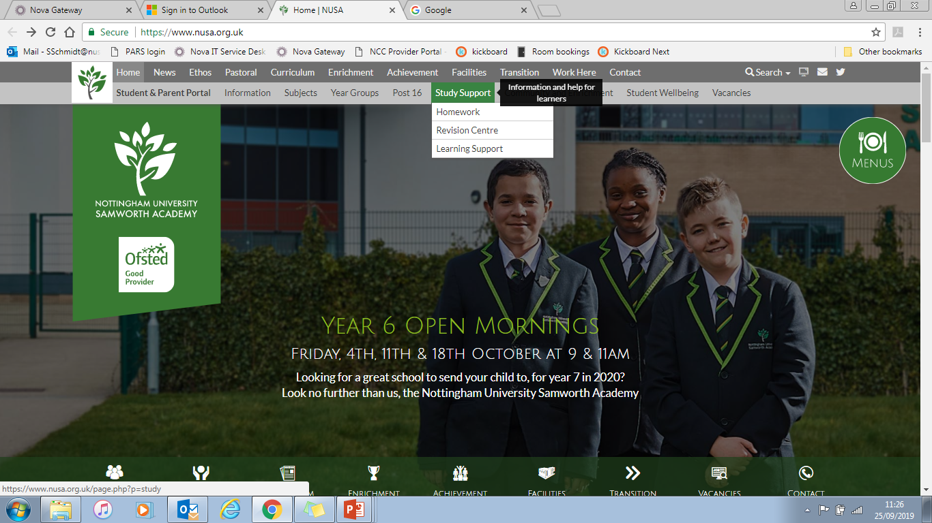
Study Support
Warm ups
Half term and holiday revision sessions
Saturday School
School website
Notes:
Following feedback from staff, students and parents, we were very keen to develop our preparation for assessments. We have centralised all aspects of preparation for assessments in one place.
Our students will learn better if they are fully prepared, know how to revise,

Slide 17
The Achievement Hub
After school provision for students from Monday to Thursday (3.10pm – 4.10pm) in the ‘Achievement Hub’
Can be voluntary OR compulsory (complete homework in a quiet environment with support)
‘Coursework Catch’ up sessions are now finished and coursework should be near to completion.

Slide 18
OUR Current priority
We have moved away from:
Coursework, Coursework Coursework
All intervention time last term was focussed around completing coursework
Intervention sessions are now in place for English, Maths, Science, Humanities and Spanish
The ‘Achievement Hub’ is open every day after school
Notes:
CRSW is now nearing completion and students should be on track
New Intervention Focus is on
Work with us…. If you and when you get notified.

Slide 19
GCSE Maths, English Language and Literature
Notes:
Importance of these subjects can not be stressed enough- they count double for students and not getting a Level 5 means that acceptance at college is in doubt

Slide 20
SUPPORT AT HOME
SUPPORT FROM HOME
Support with revision
Provide a Quiet space
Revision guides, exam papers or CDs
Encourage use of Educational Websites
Help provide equipment
Encouragement and Rewards
Sanctions when necessary
Patience!
Communicate via planner/email
Attend Parent’s Evenings
Support with sanctions when necessary
Ensure attendance at extended study classes (3.10 pm – 4.10 pm)
Check coursework is done, behaviour on ‘Kickboard’ and progress updates.
Notes:
No mobile, TV or games (Kitchen table?) You have regular constructive dialogue with them about their progress
They are fully prepared in time for End of Unit Tests and Formal assessments
They know their numbers and how to grow their numbers. OLA
Active involvement with extended study

Slide 21
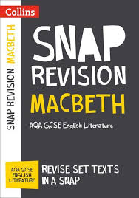
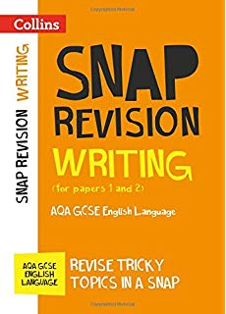
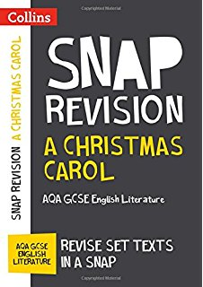
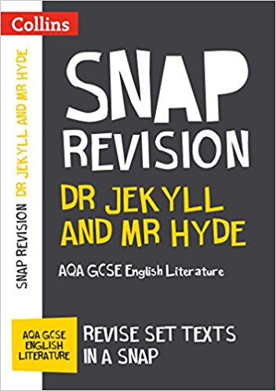
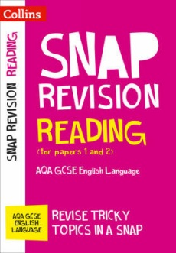
Revision guides
www.amazon.co.uk - search for ‘SNAP revision guides’ for the texts pictured

Slide 22
Success for all – Revision skills evening
Date – Wednesday 25th March 4-6pm
Each Department will have a stall representing their subject
Minimum requirement - Demonstrate how to use Knowledge organiser as a revision aide
– Revision cards / guide (and how they could be used)
Revision tips – subject specific
Websites / links where to get help
Breakdown of Exam papers / length
Carousel revision skills workshop (x3)
(Revision techniques, Online support, Managing time effectively)

Slide 23
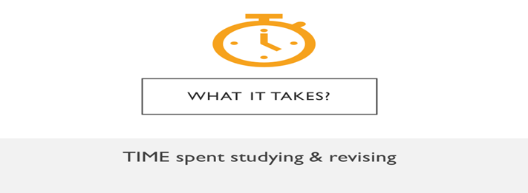
What next?
Term 1 | Year 11
Week 1 | Results Day
Week 2 | 11PC0 Deadline
Week 3
Week 4
Week 5 | Parents Evening
Week 6
Week 7 | EMS Mock Exams
Week 8 | 11 PC1 & Intervention Week
Term 1
Term 2 | Year 11
Week 1 | 11PC2 Deadline & Reports out
Week 2 | Parenst Evening
Week 3 | DAPA Meetings
Week 4
Week 5
Week 6 | Mock Maths Exams
Term 2 | Year 11
Term 3 | Year 11
Week 1 | Final Btec deadlines
Week 2
Week 3
Week 4 | Final Exams
Week 5 | Final Exams
1/2 term
Week 6 | Final Exams
Week 7 | Final Exams
Week 8
Week 9
Week 10
Week 11
Week 9
Week 10
Week 11
Week 12 | Year 11 Mock Exams
Week 13 | Year 11 Mock Exams
Week 14 | Intervention Week
Week 7 | Year 11 Exams Mocks2
Week 8 | Year 11 Exams Mocks2
Week 9 | University Visit
Week 10
Week 11 | Year 11 PC3 ‘Success for All Evening’
Week 12

Slide 24
Exam Days- last minute revision and support
At Nusa we run a series of ‘warm up’ sessions just before the exam.
If it’s a morning exam these will typically start between 7:45am and 8am.
If it’s an afternoon exam we will arrange for these to take place in school
PLEASE help your child be here on time to all ‘warm up’ sessions and exams
In 17 school weeks all is completed ☺

Slide 25
Further Inspiration
Leicester King Power Stadium - University & Apprenticeship Fair
- 13th March 2020

Slide 26
Careers and Pathways:
Brackenhurst – Aimee Smith
Nottingham College – Julia Shearer
Bilborough College – Dan Hodgson
Confetti – Barry Mallon
Nottingham University – Nick Orchard
Nottingham College – Zanna Mitchell and Emma Stevens
DANCOP – Stephanie Hughes
Rolls Royce – Anna Hills
Army – Wayne Roddis
Lead Contact: Ms Fletcher
Notes:
College applications should all have been completed!!!
We have contact with these institutions and can help if required

Slide 27
Year 11 Staff Team
Mr Schmidt (Senior Teacher & Year 11 Achievement) sschmidt@nusa.org.uk
Mr Kirkby (Head of Year 11): skirkby@nusa.org.uk
MS Dabbs (Year 11 assistant Head of Year): mdabbs@nusa.org.uk
Subject teachers will provide ongoing updates regarding CALs, predicted grades and feedback regarding progress and attitude to learning.

