Slide 1
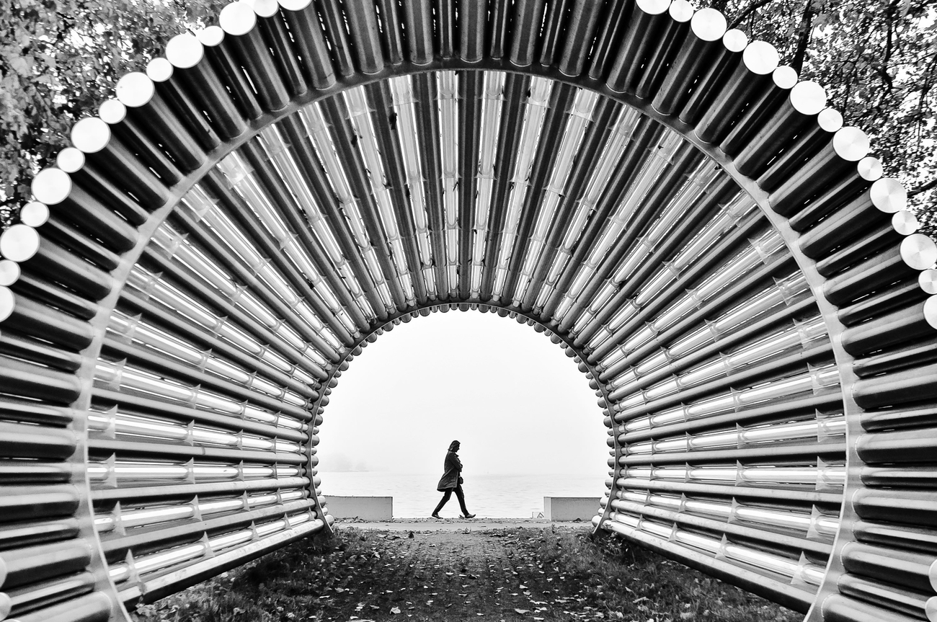
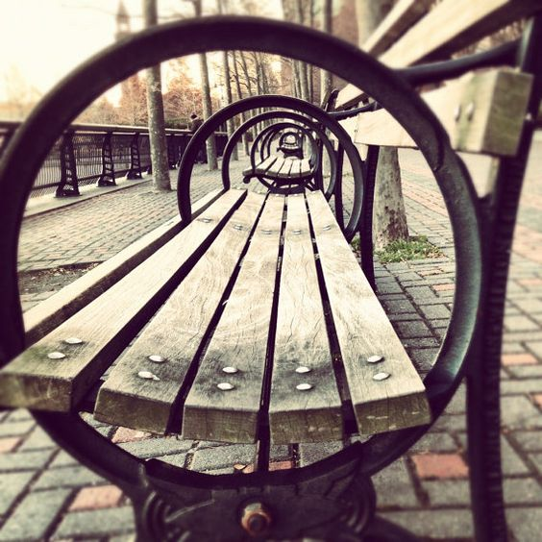
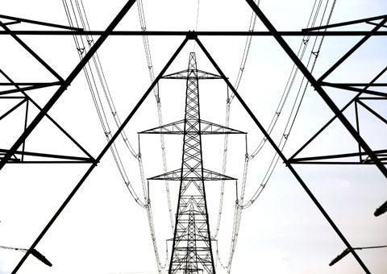
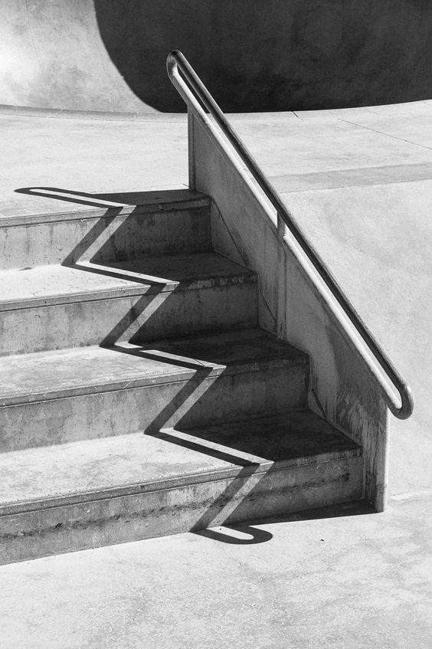
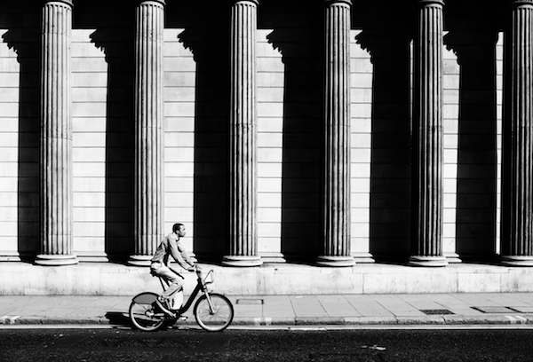
Draw the leading lines

Slide 2
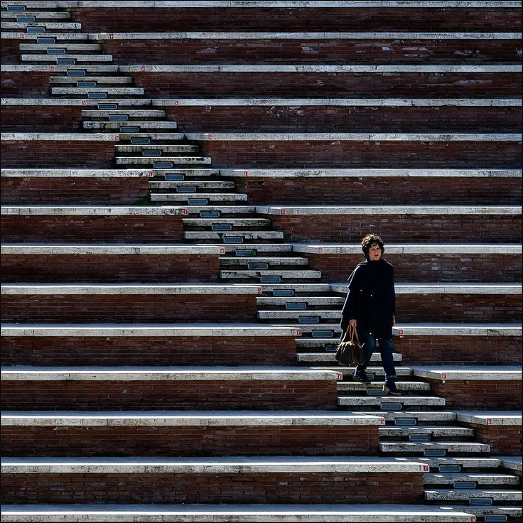
Leading lines
There are four main types of line that can be used in an image to aid composition. These are: horizontal, vertical, radial and diagonal.
Horizontal
Strong horizontal lines, such as those created by a fallen tree in a forest, a horizon or a dog lying flat-out, fast asleep, can add a sense of harmony and calm to a photo. If you want to emphasise this sense of calm, then take a landscape shot, as this will increase the width of the horizontal line. However, it is important to bear in mind that a photo with strong horizontal lines can sometimes look a little too static, even to the point of seeming dull.
2. Vertical
Strong vertical lines can add a sense of strength and power to an image (think trees and skyscrapers). To exaggerate these lines in your image, it’s often a good idea to physically turn your camera to create a portrait rather than a landscape, in order to add more drama to the vertical lines. Alternatively, if the vertical lines in your image are very strong, it might be a good idea to take a landscape shot instead, to give a sense of containment to them. Whichever way up your camera is, though, remember to keep it as straight as possible.

Slide 3
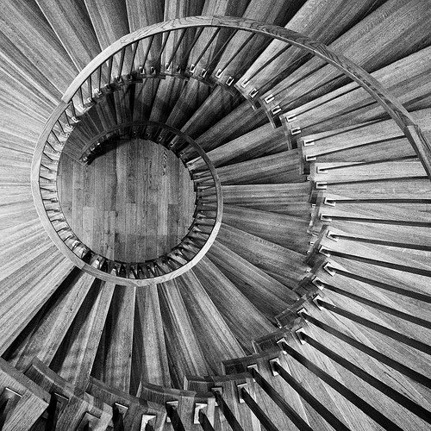
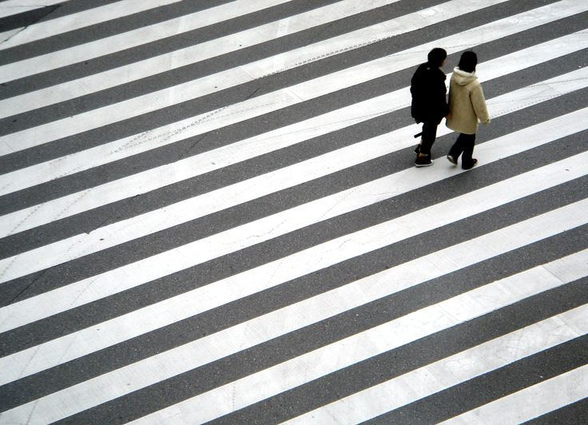
Leading lines
There are four main types of line that can be used in an image to aid composition. These are: horizontal, vertical, radial and diagonal.
3. Radial
Radial lines, such as those created by the leaves fanning out from a palm tree, or a spiral staircase, ‘burst out’ from a central point or line. These lines can be really visually exciting to explore as they force the eye to the centre of the image and back out again. Once you start noticing radial lines, you’ll see them everywhere, from umbrellas to the petals around a flower and the spokes on your bicycle.
4. diagonal
Strong diagonal lines can really lift photos, giving the sense of ‘whizzing around the page’. But be careful when composing shots with strong diagonals; make sure that the line doesn’t start in one corner of the frame and finish in the opposite one, as this can be a little predictable. It’s far better if the line starts on one side of the image and ends up at another.

Slide 4
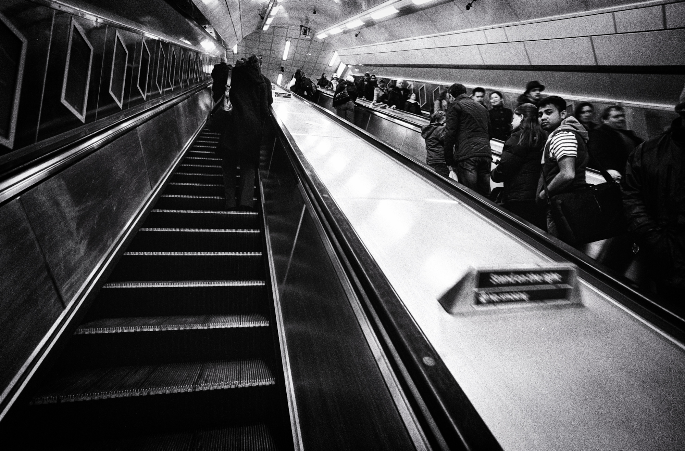
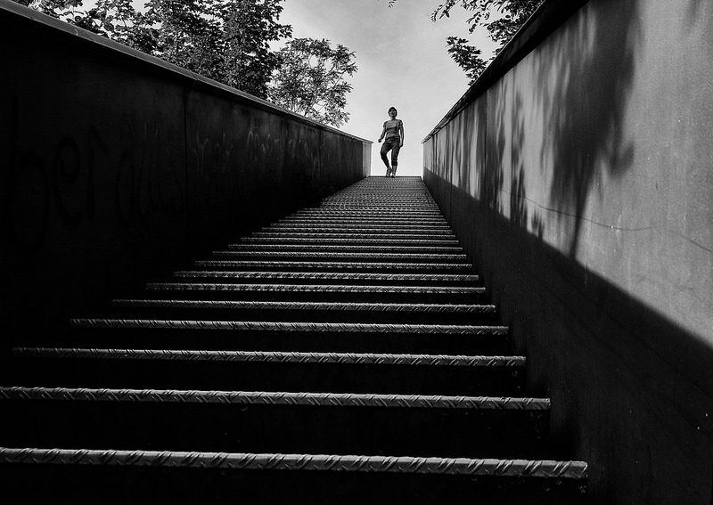
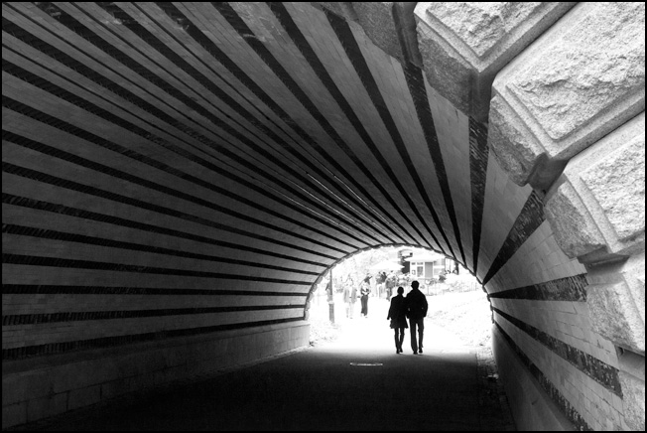
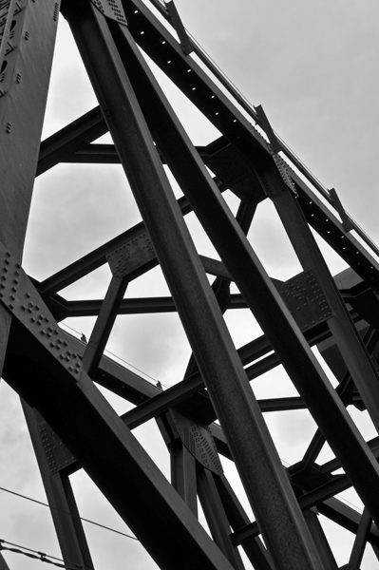
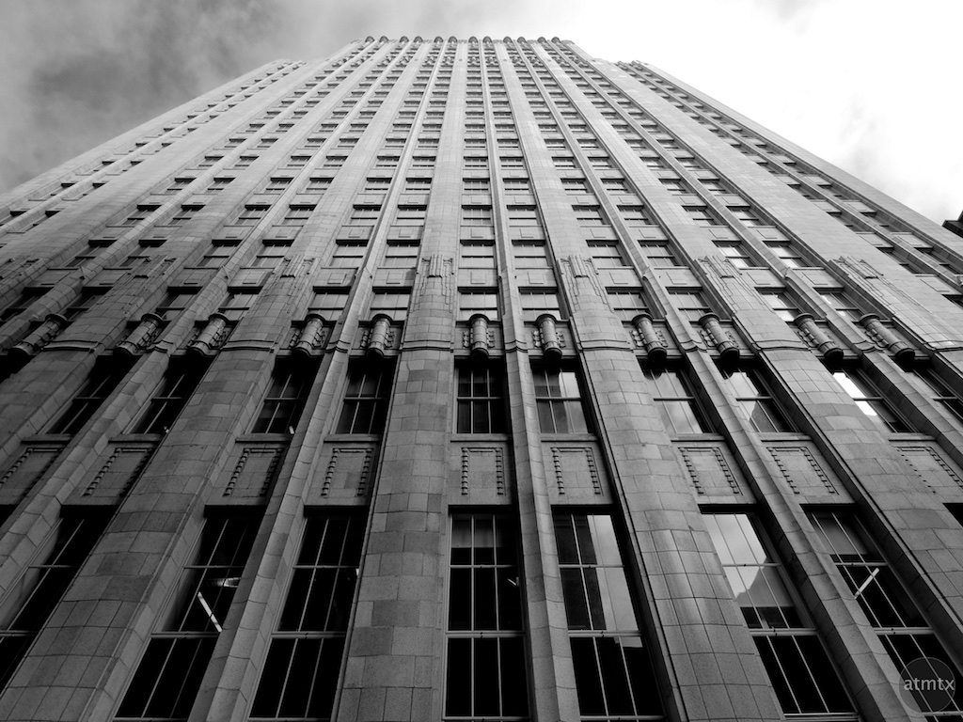
Label the Leading lines
What is the type of leading line?
Draw on top with arrows to visually show your understanding

Slide 5
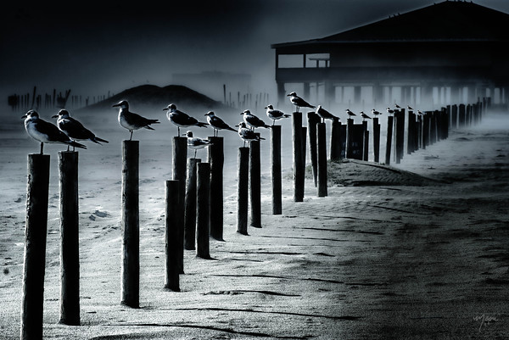
Leading Lines
Task 1
Take a set of photographs around your location that show leading lines (15-20 photos)
THESE MUST SHOW – minimum of two locations, variety of angles, vantage points and how leading lines can be created (horizontal, vertical, diagonal and radial).
AO3: RECORDING IDEAS
21-24: I have created a personal idea within the set theme. My photographs are exceptional. I can competently realise my intentions and confidently display understanding of camera skills. | 17-20: I have created a personal idea within the set theme. My photographs are highly developed and skilful. They show my understanding of camera skills and quality photo shoot planning. | 13-16: I have started to develop a personal idea within the set theme. My photographs are consistent in their quality. I understand how composition, orientation and cropping can enhance my raw images. | 9-12: My photographs display good camera control. I can compose a photograph well to the brief provided, following set rules. | 5-8: My photographs are more ‘snap shot’ style, with limited understanding to the basic composition rules. My photographs are a small selection and show no real understanding to the brief set. | 1-4: I take the minimum of photographs. The work does not show my best skills and understanding of composition, or camera control.

Slide 6
Peer assessment
LOOK AT THE PHOTOGRAPHS TAKEN SO FAR.
SUCCESS CRITERIA
Minimum of two locations
15-20 photographs
Variety of camera angles
Variety of vantage points (High, eye level and low)
Variety of leading lines (Horizontal, vertical, diagonal & radial)
Rule of thirds composition
Display different subject distances
Ao3:
Taking Photos that explore a set theme
21-24: I have created a personal idea within the set theme. My photographs are exceptional. I can competently realise my intentions and confidently display understanding of camera skills. | 17-20: I have created a personal idea within the set theme. My photographs are highly developed and skilful. They show my understanding of camera skills and quality photo shoot planning. | 13-16: I have started to develop a personal idea within the set theme. My photographs are consistent in their quality. I understand how composition, orientation and cropping can enhance my raw images.
9-12: My photographs display good camera control. I can compose a photograph well to the brief provided, following set rules. | 5-8: My photographs are more ‘snap shot’ style, with limited understanding to the basic composition rules. My photographs are a small selection and show no real understanding to the brief set. | 1-4: I take the minimum of photographs. The work does not show my best skills and understanding of composition, or camera control.
TARGETS FOR IMPROVEMENT:
21-24 | 17-20 | 13-16 | 9-12 | 5-8 | 1-4

Slide 7
Task 2
Presenting raw and best photographs
SUCCESS CRITERIA
Minimum of ten raw photographs
Photos presented neatly
Ticks and crosses
Annotation to explain ticks and crosses
Digitally draw on the angle and direction of the leading lines
Compositional rules shown through drawing (5+)
Questions to answer:
What is the vantage point of your photograph?
How have you used rule of thirds and placement of the focal point to create a dynamic composition?
How would you improve the photograph when taking it again?
CHALLENGE QUESTION:
How has your vantage point created distance, perspective, movement, focal point, direction?
Aim Higher: Use basic adjustments on raw images to enhance the quality

Slide 8
Task 3
Leading Lines Improvement shoot:
Produce a set of six photographs
*You should take 10-15 raw images to choose the best six from
Your work should:
Demonstrate how the frame can be used to create compositions of shape, line and pattern.
Display different subject distances e.g. close up and far away.
Show that you have considered the rule of thirds.
Demonstrate the creative use of line in developing your compositions.
Make use of different vantage points (high, low, eye level)
Show consideration of the foreground and background.
Aim Higher: Review and Refine Photographs as you go along. Finding interesting locations not only on the school site.

Slide 9
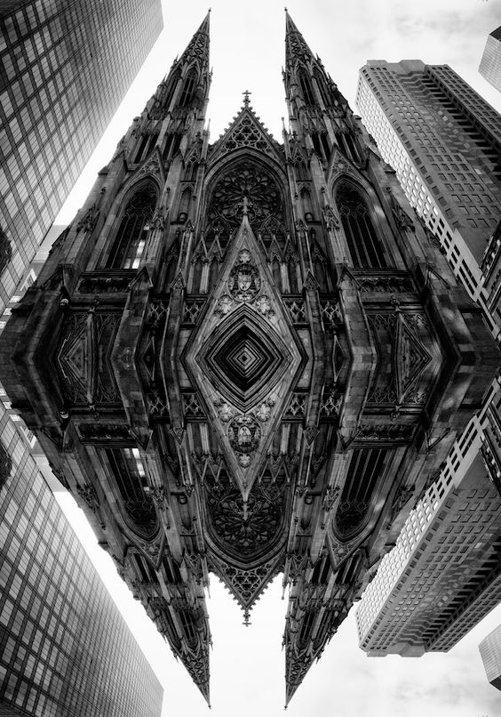
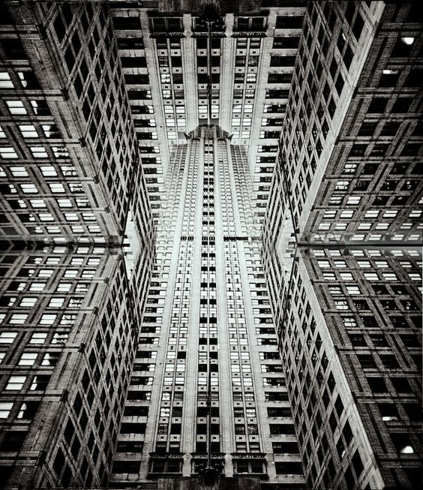
Homework:
Research Brad sloan
Create a photographers page
Photographers Name
6 Images of their work
Question to answer:
How does Brad Sloan manipulate and digitally alter his photographs to create the compositions?
Include Photoshop terminology in your answer.

