Slide 1
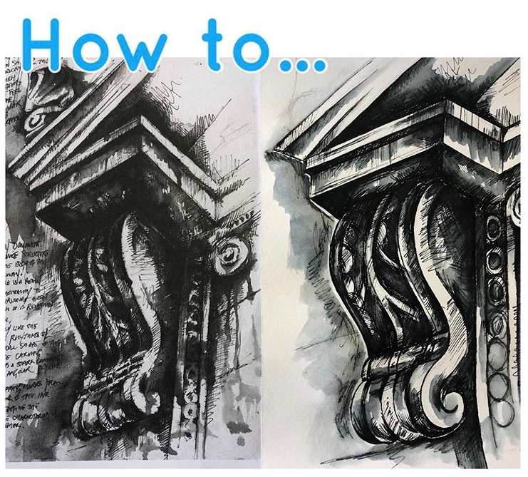
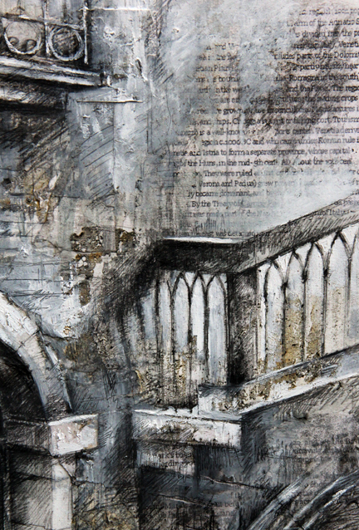
Year 9 who need a break from day of the dead, have a go at following the step by step guide that’s influenced by Ian Murphy.
Aim higher and work ontop of interesting papers.
Newspaper
Magazines
Envelopes

Slide 2
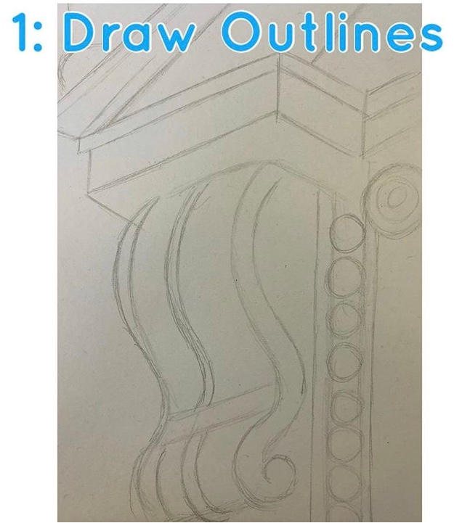

Slide 3
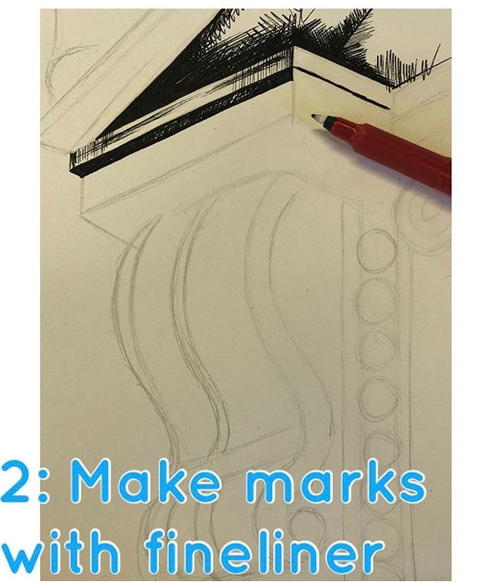

Slide 4
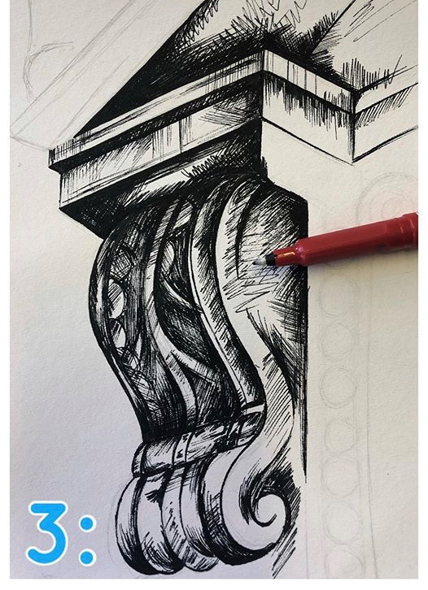

Slide 5
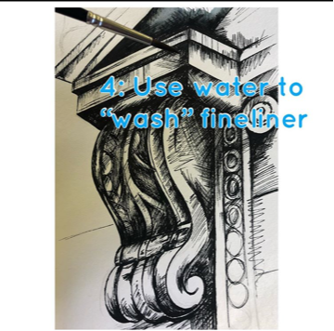

Slide 6
