Slide 1
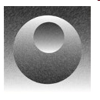
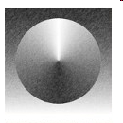
NAME:
Practising TONE
Look at the examples below.
Copy TWO of these into the empty boxes underneath.
Try to blend one tone smoothly into another using a PENCIL CRAYON.

Slide 2
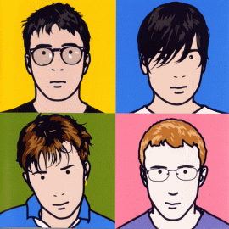
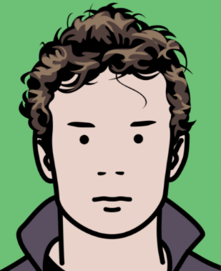
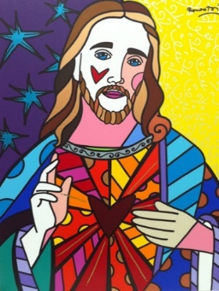
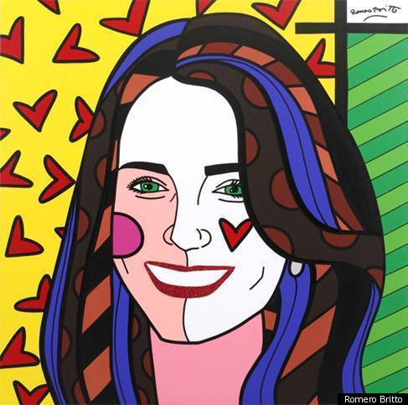
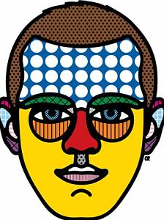
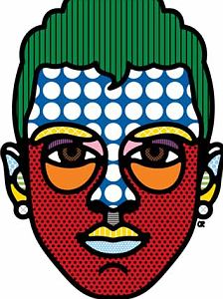
Independent Project - artist page
AO1
Initiative dedication accountability creativity achieving
Find and Use previous Prep 4 Learning:
6-8 images of your chosen artists’ portraiture work
Arrange on A4 sheet with title
Aim Higher: decorate the page in your artist style
Explain what you like about the artwork
2. Complete an A5 visual analysis of one of the portrait images
In any media (paint, crayon, ICT) that you feel will produce the best result
Aim Higher: present alongside the original in a thoughtful manner
ARTIST: Julian Opie
ARTIST: Romero Britto
ARTIST: Craig Redman
Notes:
Set the home study in the first lesson. Do give the students 2-3weeks to complete the work. Both elements need to be handed in for homework to be completed. It is always an idea to make it clear you will set after-school detentions for work not handed in as it isn’t just a small homework task.
Remember to remind them each week about the homework, until the deadline.
Examples are on Art Moodle.

Slide 3
Independent Project - artist page student example

Slide 4
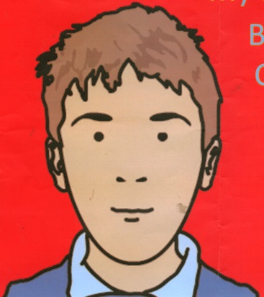
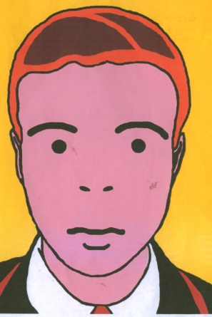
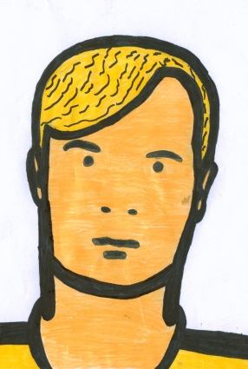
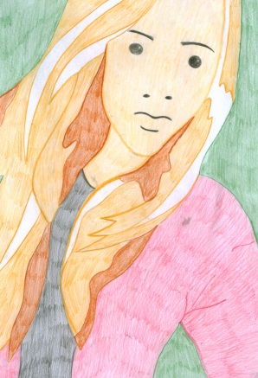
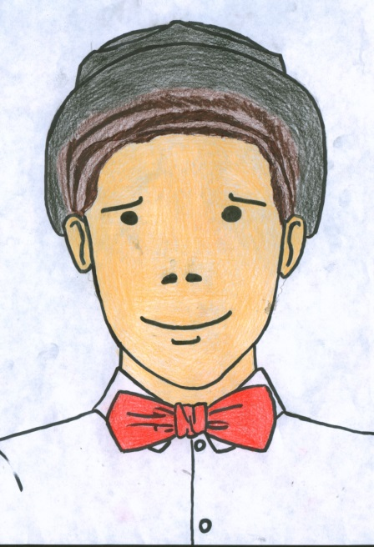
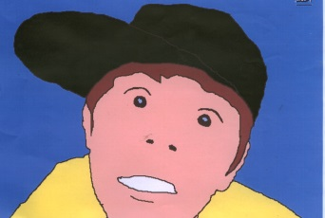
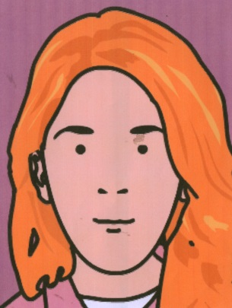
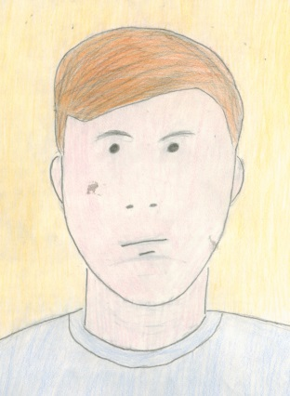
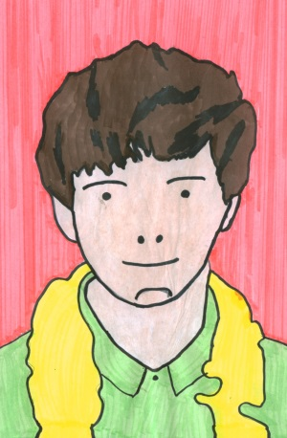
Independent task
Produce a self portrait fully in the style of Julian Opie
Use a photo to get the proportion correct
Trace outline etc
Alter the style to show Opie’s characteristics
Apply colour neatly
A4 in size
High Achiever ICT EXAMPLE –
High Achiever

Slide 5
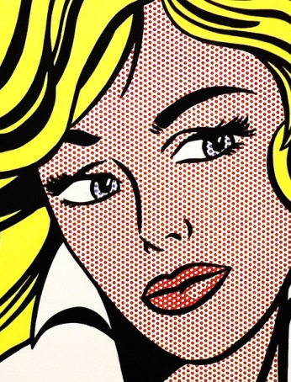
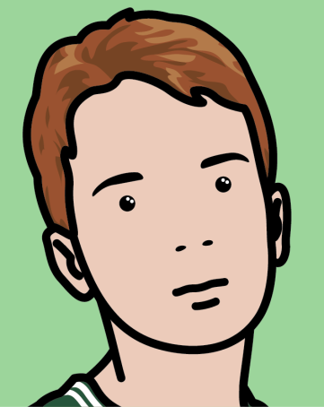
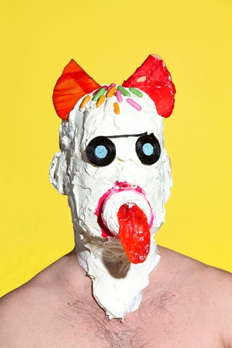
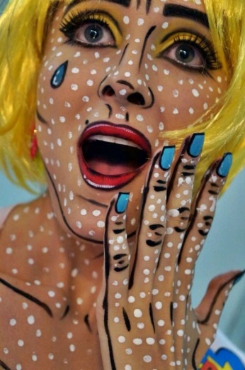
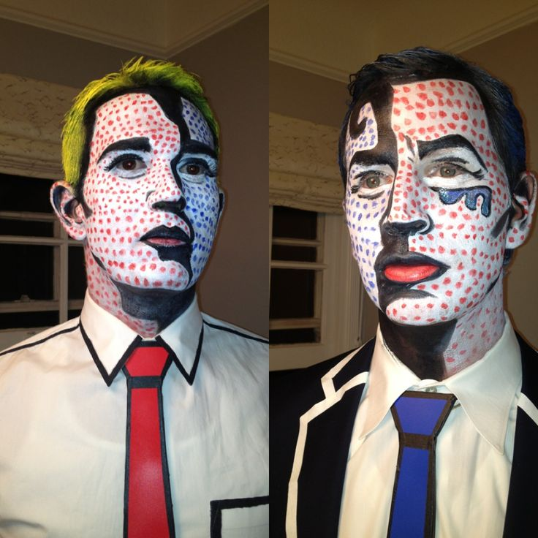
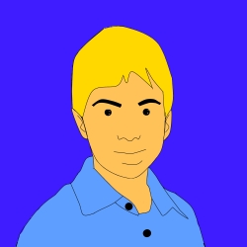
Alternative portrait
To complete the project you must provide
Artist research
Planning or development thumbnails (how you did it)
Final image/sculpture
Produce a portrait in the style of your chosen artist
Face paint
Make up
ICT*
Photography
Food
3D model
Roy Lichtenstein
Julian Opie
James Ostrer
https://twitter.com/LouiseClazey/status/607658644784750593/video/1
*ICT help sheet

Slide 6
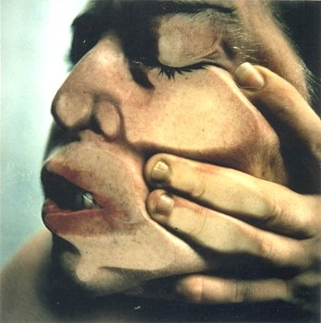
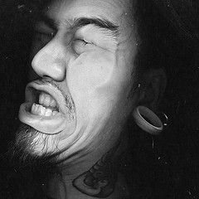
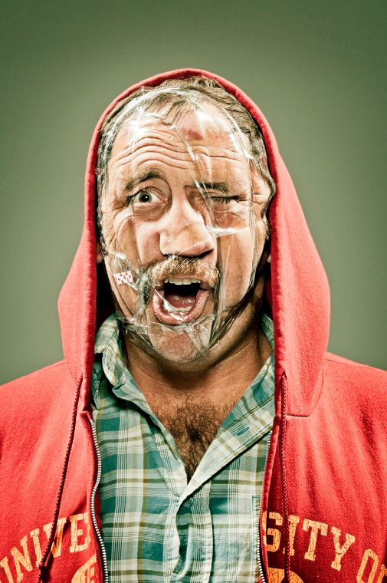
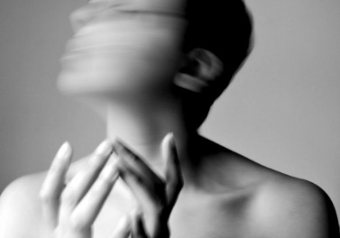
Distorted Portrait Homework Project
Use your camera to create a distorted portrait.
Look at the examples provided, do your own independent research
Have a practice, see what works best for you.
Jenny Saville
To complete work you must hand-in:
Research
Practise images
Final image with written paragraph about how you achieved the final outcome
Scanography
Movement Photography
Wes Naman

