Slide 1
Design and Technology
Home schooling pack
Year Group:
My name:
Form:
Date:

Slide 2
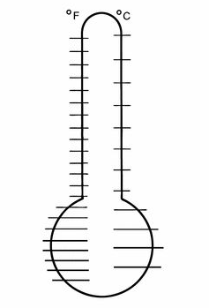
Food hygiene in the hospitality and catering industry
1. What is the role of the environmental health officer?
Reference :
2.What are temperature control regulation?
Reference:
3. What is the environment needed for bacteria to multiply.
*
*
*
*
Reference:
4.
Reference:
Label the key temperatures on the thermometer.
5. What type of bacteria is found in raw meat and poultry ?
*
*
*
Reference:
7. What are the rules for reheating food?
Reference:
6. What is Pathogenic Bacteria ? What are the main sources of food poisoning ?
*
*
*
*
Reference:
8. What is cross-contamination ? How is this caused?
Reference:
9. How can cross-contamination be prevented?
Reference:

Slide 3
Food hygiene in the hospitality and catering industry
10. Complete the section and storage of the fridge:
Describe why foods are separated:
Reference:
Door
Frozen
11. Describe the protective clothing needed for working in an food factory.
*
*
*
*
Reference:
Raw meat, explain why
12. What are the temperatures for refrigerator and freezer?
*
*
Reference:
Write down and explain 3 food hygiene rules:
1)
2)
3)

Slide 4
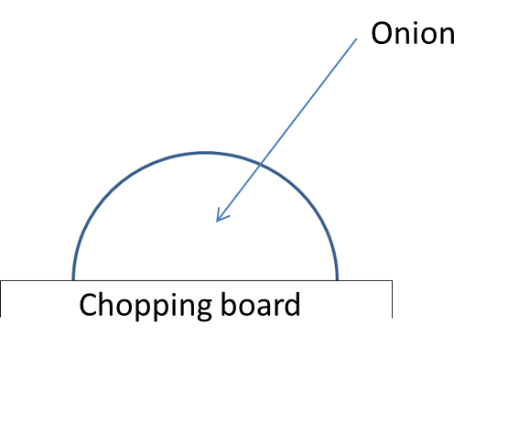

Health and safety task
Bridge
Draw a diagram of how the hand is positioned for bridge and claw method.
Colour in the correct chopping board colour for onion
Meat
Fish
Cooked meat
Root vegetables
Dairy
Claw
What is cross-contamination?

Slide 5
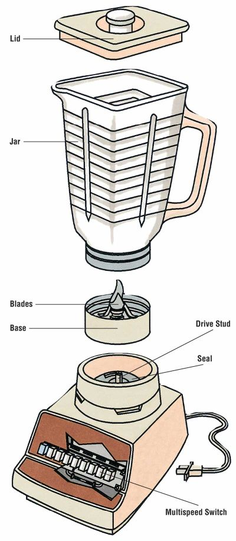
Health and safety task
Blender cleaning and assembly
Label the most important things you need to remember when putting a blender back together after washing it.
Draw an arrow to each bit and explain why.
Give 6 health and safety rules when using a blender in a smoothie practical.
1.
2.
3.
4.
5.
6.

Slide 6
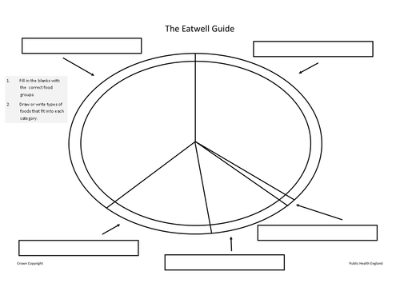
Water
What are micro nutrients ?
What are macro nutrients ?

Slide 7


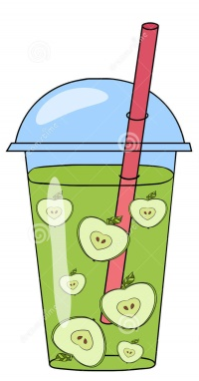
Fruit smoothie
design
Label your fruit
Colour it in and draw the fruit
Draw and label the 3 or more fruits you would like to use in your fruit smoothie.
Write the list of ingredients below- write the reason next to it: flavour, vitamins, colour, texture etc.
Ingredients: For what reason? Vitamin/ colour/texture /flavour
1. Milk
2. Yogurt
3.
4.
5.
6.
7.
Why is Calcium important for the body in young people?.....................................................................................
.....…………………………………………………………………………………………………………………………………………………………………….
…………………………………………………………………………………………………...........................................................................
.................................................................................................................................................................................
How can we make sure a smoothie is healthy?......................................................................................................
………………………………………………………………………………………………………………………………………………………………………….
………………………………………………………………………………………………………………………………………………………………………….
………………………………………………………………………………………………………………………………………………………………………….
Why are Vitamins important for the body?............................................................................................................
………………………………………………………………………………………………………………………………………………………………………….
…………………………………………………………………………………………………………………………………………………………………………………………………………………………………………………………………………………………………………………………………………………….
Example apple
Smoothie

Slide 8
Learning Intention:
Designing a pizza naan
Brief: Must contain as many of the green sections of the Eatwell plate as possible
Describe the design of you pizza
What does it taste like?…………………………………………
………………………………………………………………………………………………………………………………………………………………………………………………………………………………………………………………………………………………………………………….....
Is it healthy?………………………………………………………….
……………………………………………………………………………………………………………………………………………………………………………………………………………………………………………………………………………………………………………………………………………………………………………………………………………………………………………………………………………………………...
What does it taste like?…………………………………………
………………………………………………………………………………………………………………………………………………………………………………………………………………………………………………………………………………………………………………………….....
Is it healthy?………………………………………………………….
……………………………………………………………………………………………………………………………………………………………………………………………………………………………………………………………………………………………………………………………………………………………………………………………………………………………………………………………………………………………...
What does it taste like?…………………………………………
………………………………………………………………………………………………………………………………………………………………………………………………………………………………………………………………………………………………………………………….....
Is it healthy?………………………………………………………….
……………………………………………………………………………………………………………………………………………………………………………………………………………………………………………………………………………………………………………………………………………………………………………………………………………………………………………………………………………………………...

Slide 9
……………………………………………………………………………………………………………………………………………………………………………………………………………………………………………………………………………………………………………………………………………………………………………………………………………………………………………………………………………………………………………………………………………………………………………………………………………………………………………………………………………………………………………………………………………………………………………………………………………………………………………………………………………………………………………………………………………….…………………………………………………………………………………………………………………………………………………………………………………………………………………………………………………………………………………………………………………………………………………………………………………………………………………………………………………………………………………………………………………………………………………………………………………………………………………………………………………………………………………………………………………………………………………………………………………………………………………………………………………………………………………………………………………………………………………………………………………………………………………………………………………………………………………………………………………………………………………………………………………………………………………………………………………………………………………………………………………………………………….…………………………………………………………………………………………………………………………………………………………………………………………………………………………………………………………………………………………………………………………………………………………………………………………………………………………………………………………………………………………………………………………………………………………………………………….……………………………………………………………………………………………………………………………………………………………………………………………………………………………………………………………………………………………………………………………………………………………………………………………………………………………………………………………………………………………………………………………………………………………………………………………………………………………………….
Name:…………….. Learning intention :……………….
Final Design: Pizza
Label and describe the design of you pizza
Toppings ……………………………………………………………………………………………………………………………………………………………………………………………………………………………………………………………………………………………………………………………………………………………………………………………………………………………………………………………………………………………………………………………………………………………………………………..………………………………………………………………………………………………………….

Slide 10
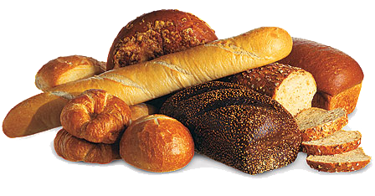
Learning Intention: The science of B_ _ _ _ and the R_ _ ct_ on_ that cause the bread to rise.
Bread
Bread is eaten all over the world. It is often described as a staple food.
Use the words here as prompts to write down what happens with the mixture when you made bread.
  ) Strong or bread flour
  )When wet becomes stretchy
  )Yeast Single-celled, living organism
  )Needs food, warmth, moisture and time;
  )Fermentation Carbon Dioxide gas (CO2)
  )Alcohol CO2 gas makes dough balloon
  )Heat kills yeast
  )Evaporates
  )Contains protein called GLUTEN
When making bread the ingredients that are used Are…………………………………………………………………………………………………………
………………………………………………………………………………………………………………………………………………………………………………………………………………………………………………………………………………………………………………………………………………………………………………………………………………………………………………………………………………………………………………………………………………………………………………………………………………………………………………………………………………………………………………………………
Watch the website for information to complete this work:
https://www.youtube.com/watch?v=tSNvmr41RSQ
Staple- what is a staple food?..........................................................................................…………………………
…………………………………………………………………………………………………………………………………
Can you give an example of another staple Food?.....................................................………………………..
What is the main component that makes something a carbohydrate?……………………………………………….
Number them in the order they happen to help you plan your answer.
Name different types of dietary and cultural bread: What country do they come from?
There are many ways bread is used in both savoury and deserts here are some example: Toast, burgers buns.
Now add some of your own.

Slide 11
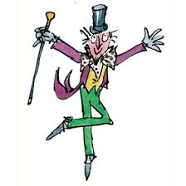
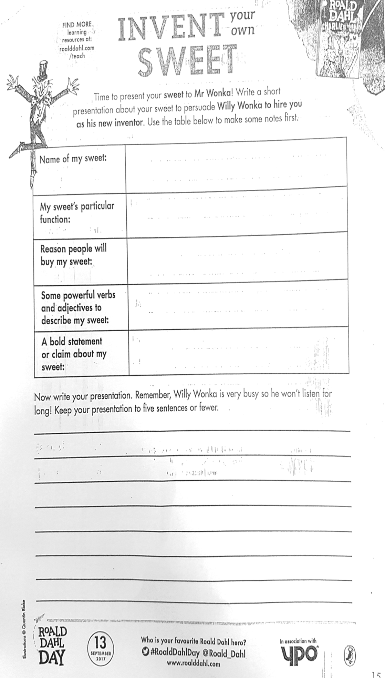
Now write your presentation. Remember, Willy Wonka is very busy so he won’t listen for long! Keep your presentation entertaining and interesting to win the reader over!……………………………………………………………………………………………………..
…………………………………………………………………………………………………………………………………………………………………………………………………………………………………………………………………………………………………………………………………………………………………………………………………………………………………………………………………………………………………………………………………………………………………………………………………………………………………………………………………………………………………………………………………………………………………………………………………………………………………………….…………………………………………………………………………………………………………………………………………………………………………………………………………………………………………………………………………………………………………………………………………………………………………………………………………………………………………………………………………………………………………………………………………………………………………………………………………………………………………………………………………………………………………………………………………………………………………………………………………………………………………………………………………………………………………………………………………………………………………………………………………………………………………………………………………………………………………………………………………………………………………………………………………………………………………………………………………………………………………………………………………….…………………………………………………………………………………………………………………………………………………………………………………………………………………………………………………………………………………………………………………………………………………………………………………………………………………………………………………………………………………………………………………………………………………………………………………….………………………………………………………………………………………………………………………………………………………………………………………………………………………………………………………………………………………………………………………………………………………………………………………………………………………………………
Time to present your sweet to Mr Wonka! Write a short presentation about your sweet to persuade Mr Wonka to
hire you as his new inventor, use the table below to make notes at first, be ask CREATIVE as possible!
Name of sweet:
My sweet’s magic aspect or function
Reason people will buy my sweet:
Some powerful verbs and adjectives to describe my sweet:
A bold statement or claim about my sweet:

Slide 12

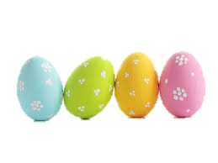
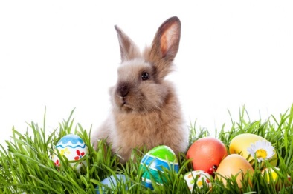
Designing A Celebration Muffin
Brief: Design a Easter Cake that could be sold in shops this Easter novelty theme.

Slide 13

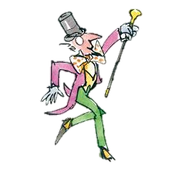

Brief: Design a Mr Wonka sweet and persuade Willy Wonka to hire you as his new sweet inventor .
Name:
Name of sweet:
Logo design:
Sweet Design, using pictures and labels, describing it in detail.
Sweet Slogan, can you use alliteration in your slogan, to make it memorable :

Slide 14
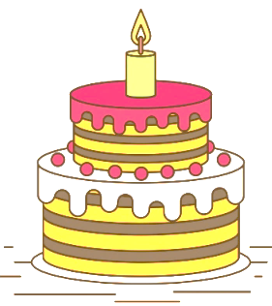
Novelty Design
For a cake
Design a novelty cake and its packaging that can be sold in a supermarket for special occasions. Label your ideas to explain your design
Birthday cake packaging design

Slide 15
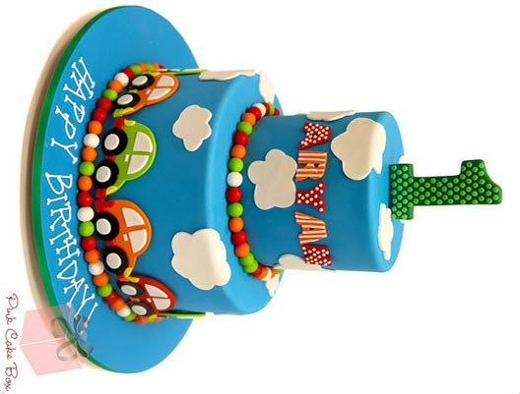
……………………………………………………………………………………………………………………………………………………………………………………………………………………………………………………………………………………………………………………………………………………………………………………………………………………………………………………………………………………………………………………………………………………………………………………………………………………………………………………………………………………………………………………………………………………………………………………………………………………………………………………………………………………………………………………………………………….…………………………………………………………………………………………………………………………………………………………………………………………………………………………………………………………………………………………………………………………………………………………………………………………………………………………………………………………………………………………………………………………………………………………………………………………………………………………………………………………………………………………………………………………………………………………………………………………………………………………………………………………………………………………………………………………………………………………………………………………………………………………………………………………………………………………………………………………………………………………………………………………………………………………………………………………………………………………………………………………………………….…………………………………………………………………………………………………………………………………………………………………………………………………………………………………………………………………………………………………………………………………………………………………………………………………………………………………………………………………………………………………………………………………………………………………………………….……………………………………………………………………………………………………………………………………………………………………………………………………………………………………………………………………………………………………………………………………………………………………………………………………………………………………………………………………………………………………………………………………………………………………………………………………………………………………….
Final Design: Cake
Label and describe the design
Toppings/ ingredients ……………………………………………………………………………………………………………………………………………………………………………………………………………………………………………………………………………………………………………………………………………………………………………………………………………………………………………………………………………………………………………………………………………………………………………………..………………………………………………………………………………………………………….
Write a radio jingle/ advert to sell you cake, use persuasive language

