Slide 1
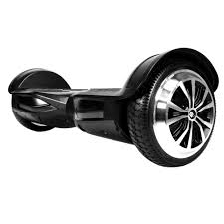
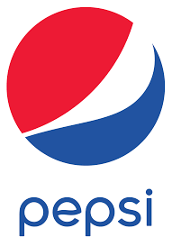
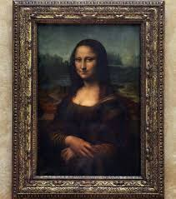
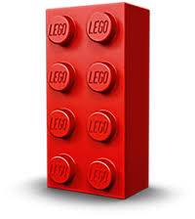
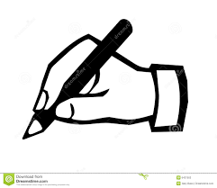
ENGINEERING DESIGN R105 - TOPIC ON A PAGE
Protecting ideas…. Trademark, copyright,patent.
What is:
A TRADEMARK______________________________
__________________________________________
A COPYRIGHT_______________________________
__________________________________________
A PATENT__________________________________
__________________________________________
Indicate if these are Copyright (C), Trademark (Tm) or Patent (PP)
Why do companies feel the need to protect their property in this way? ____________________________________________________________________________________
__________________________________________
What would happen if another company broke these rules by copying?_______________________
______________________________________________________________________________________________________________________________
Why do companies use these symbols?
_________________________________________________________________________________________________________________________________________________________________________________________________________________________________
Identify how McDonalds protects its identity and ideas from competition, making reference to the types of protection available (5 marks)
____________________________________________________________________________________________________________________________________________________________________________________________________________________________________________________________
WHAT YOU NEED TO KNOW | ∕
Copyright, trademark and patent are all used to legally protect a companies intellectual property
They are all used to protect slightly different aspects of the business
The law is used to back up this protection with possibilities of fines and even jail time

