Slide 1
What worries you about the assessment?
On your post it, write down what you are worried about for this assessment.
Be as HONEST as you can.

Slide 2
Literature Paper 2: Section A Modern texts and poetry
Learning:
To understand the requirements for the Literature exam
Outcome:
Prepare for the assessment

Slide 3
During this lesson, I will be going through:
What the exam is about
What the examiner is looking for
How we can prepare for the exam
How you can prepare for the exam
Notes:
Rationale
At this stage, it is important that pupils are able to understand what my outline of the lesson is and how the lesson will proceed.
By outlining the progress to be made in the lesson, I am trying to reinforce the value of growth.
Addressing Learning Styles
This will be an auditory activity as pupils listen to me speak, though the visual aids will also support learning. I will also refer to the traffic light cards that are in the pupils’ folders as an AfL method to be used throughout out the lesson.

Slide 4
Modern texts and poetry
What's assessed:
• Modern texts
• Poetry
• Unseen poetry
How it's assessed:
• written exam: 2 hour 15 minutes
• 96 marks
• 60% of GCSE
Questions:
Section A Modern texts: students will answer one essay question from a choice of two on their studied modern prose or drama text.
Section B Poetry: students will answer one comparative question on one named poem
printed on the paper and one other poem from their chosen anthology cluster.
Section C Unseen poetry: Students will answer one question on one unseen poem
and one question comparing this poem with a second unseen poem.

Slide 5
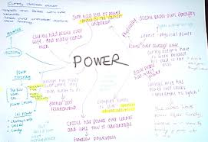
Timings…
Approximately 40 mins to respond to the question
5 minutes to plan.

Slide 6
During this lesson, I will be going through:
What the exam is about
What the examiner is looking for
How we can prepare for the exam
How you can prepare for the exam
Notes:
Rationale
At this stage, it is important that pupils are able to understand what my outline of the lesson is and how the lesson will proceed.
By outlining the progress to be made in the lesson, I am trying to reinforce the value of growth.
Addressing Learning Styles
This will be an auditory activity as pupils listen to me speak, though the visual aids will also support learning. I will also refer to the traffic light cards that are in the pupils’ folders as an AfL method to be used throughout out the lesson.

Slide 7
How and why does Sheila change in An Inspector Calls?
Write about:
how Sheila responds to her family and to the Inspector
how Priestley presents Sheila by the ways he writes.
[30 marks]
AO4 [4 marks]

Slide 8
Section A: Modern texts Questions 1–24 (30 marks – AO1=12, AO2=12, AO3=6)
Level 6
AO1
Critical, exploratory, conceptualised response to task and whole text
Judicious use of precise references to the full task supported by a range of judicious references.
AO2
Analysis of writer’s methods with subject terminology used judiciously
Exploration of effects of writer’s methods on reader
AO3
Exploration of ideas/perspectives/contextual factors shown by specific, detailed links between context/text/task

Slide 9
Things to remember…
You do not have an extract.
You must learn quotations
You can paraphrase but this will not gain you marks for A02
You must refer to context as it is relevant

Slide 10
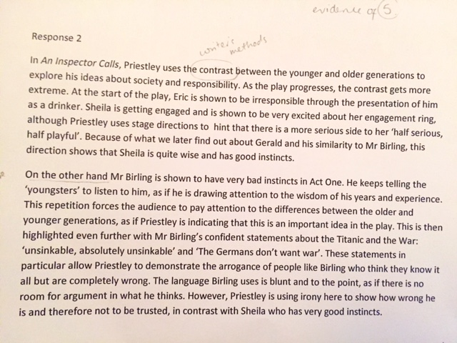
Using you mark scheme what level is this response?

Slide 11
During this lesson, I will be going through:
What the exam is about
What the examiner is looking for
How we can prepare for the exam
How you can prepare for the exam
Notes:
Rationale
At this stage, it is important that pupils are able to understand what my outline of the lesson is and how the lesson will proceed.
By outlining the progress to be made in the lesson, I am trying to reinforce the value of growth.
Addressing Learning Styles
This will be an auditory activity as pupils listen to me speak, though the visual aids will also support learning. I will also refer to the traffic light cards that are in the pupils’ folders as an AfL method to be used throughout out the lesson.

Slide 12
Plan, plan, plan…
Aim for 3-4 paragraphs (3-4 main points)
Use the learning ladder
Prepare, prepare, prepare…
Unpick the question
Recall the AOs (Learning ladder)
Revise character and plot
Learn quotations

Slide 13
How and why does Sheila change in An Inspector Calls?
Write about:
how Sheila responds to her family and to the Inspector
how Priestley presents Sheila by the ways he writes.
[30 marks]
AO4 [4 marks]

Slide 14
During this lesson, I will be going through:
What the exam is about
What the examiner is looking for
How we can prepare for the exam
How you can prepare for the exam
Notes:
Rationale
At this stage, it is important that pupils are able to understand what my outline of the lesson is and how the lesson will proceed.
By outlining the progress to be made in the lesson, I am trying to reinforce the value of growth.
Addressing Learning Styles
This will be an auditory activity as pupils listen to me speak, though the visual aids will also support learning. I will also refer to the traffic light cards that are in the pupils’ folders as an AfL method to be used throughout out the lesson.

Slide 15
How can YOU prepare for the exams?
Revision Guides.
GCSE bitesize
Mr Bruff youtube
Preparing notes
Practice essay plans
Learn quotations

Slide 16
What are you going to do TONIGHT to prepare for this exam?
Write a plan in your book of what you will need to do to prepare. Think about:
Planning
Quotations
Learning ladder

