Slide 1
Paper 1 Question 3
Paragraph 1
Paragraph 2
Paragraph 3
1-2 Marks
What happens in the text?
- Beginning
- Middle
- End
Give a quotation for each of this plot points.
3-5 Marks
Comment on the effect that the opening/ending have on the reader.
Is there a shift?
- Change in setting
- Change in character
- Change in tone
What different sentence lengths/types are being used? What effect do these have on the reader?
What is the Narrative Perspective? What is the effect of this?
6-8 Marks
Comment on Structural Features and the effect they create:
- Flashback
- Dialogue
- Cliff hanger
- Punctuation for effect
- Juxtaposition / Paradox
- Foreshadowing
- Listing
Make a comment on the overall structure of the text and why you thing the writer has done this:
- Linear Narrative
- Non-Linear Narrative
- Chronological
Key Phrases:
The writer focuses our attention on…
The writer changes our focus to…
The text shifts from ____ to ____ …
Buzz Words:
Shift Focus
Beginning Middle
End
Grade 9

Slide 2
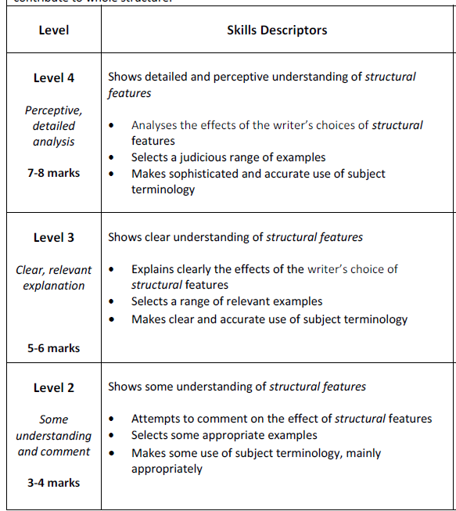
It is not ok to just identify different structural features… you must analyse what effect these have on the reader.
You will need to analyse a minimum of 4 quotations to be able to hit this level.
Ideally you want to include 4-6 quotations.
You must use subject terminology, otherwise you cannot get above 2marks.

