Slide 1
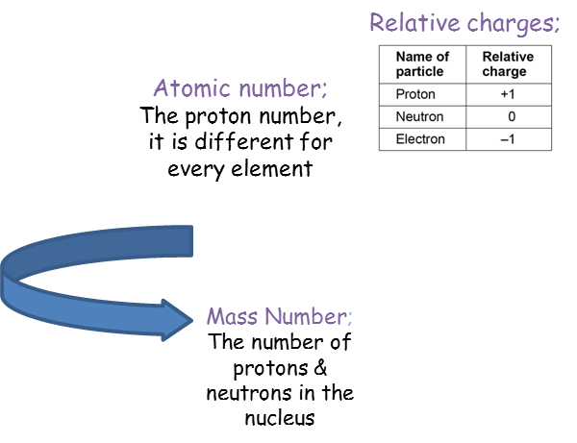
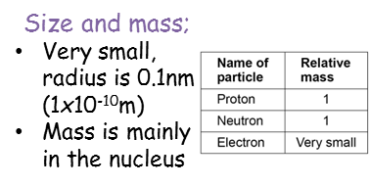
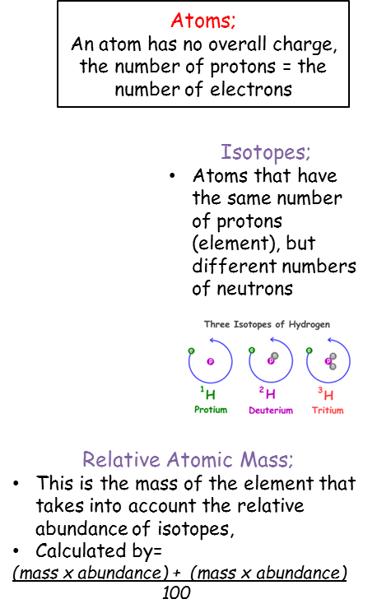
GCSE Knowledge Organiser Unit 1 Atomic Structure
NUSA
SCIENCE
TWO
ONE
THREE
FOUR

Slide 2
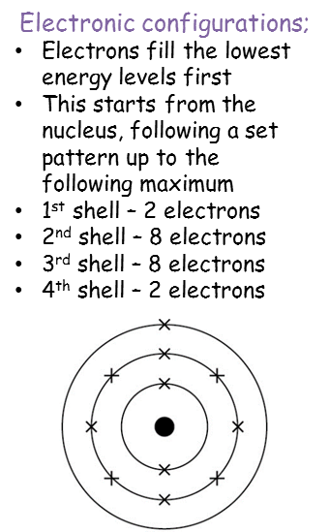
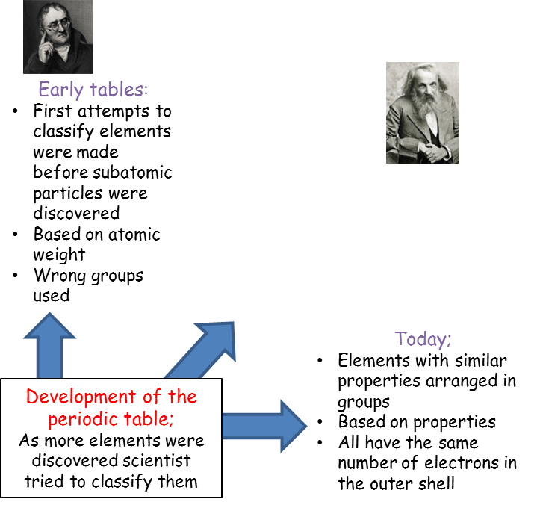
GCSE Knowledge Organiser Unit 1 Atomic Structure
NUSA
SCIENCE
FIVE
SIX
SEVEN
EIGHT

