Slide 1
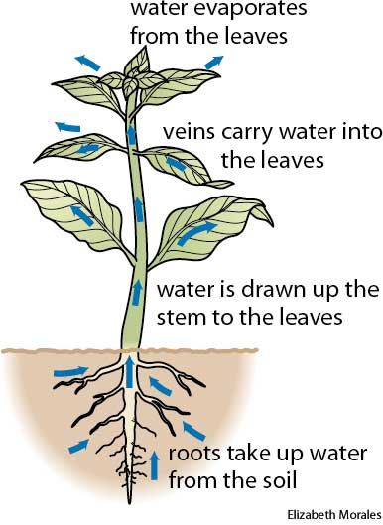
GCSE Knowledge Organiser Unit 2.2 – Plants and Photosynthesis
NUSA
SCIENCE
ONE – SPECIALLISED PLANT CELLS
TWO – PLANT TISSUES AND ORGANS
SPECIALISED CELLS
Specialised Cell | How structure relates to function
Root hair cell | Long extension to increase surface area for water and mineral uptake; thin cell wall.
Xylem cell | Waterproofed cell wall; cells are hollow to allow water to move through.
Phloem cell | Some cells have lots of mitochondria for active transport; some cells have very little cytoplasm for sugars to move through easily.
Palisade cell | Lots of chloroplasts to absorb lots of light and increase rate of photosynthesis.
Guard cell | Flat, thin, kidney bean shape enables two cells to form a pore to allow carbon dioxide in. Large vacuole to regulate osmotic pressure and control the opening and closing of the stoma.
Cell – the smallest unit of an organism
Tissue – consists of groups of similar cells
Organ – contain different tissue working together to carry out a function
Organ system – contains different organs
Organism
Type of tissue | Properties | Function
Meristem tissue | Found in the growing tips of roots and shoots. Can differentiate (divide) into any type of plant cell. | Can be used to clone rare species to prevent extinction.
Xylem | Long hollow tube strengthened by lignin found throughout the plant. | Transport water from the roots to shoots and leaves.
Phloem | Composed of sieve cells and companion cells. | Transports sugars from the leaves to elsewhere in the plant.
THREE – TRANSPIRATION
FOUR - PHOTOSYNTHESIS
DEFINITIONS
Transpiration | The loss of water vapour from a leaf, mainly through the stomata.
Transpiration stream | The movement of water through a plant from the roots, up the stem and then out through the leaves.
Photosynthesis takes place in the chloroplasts in the cells of the leaves of plants. The chloroplasts contain the chlorophyll, which absorbs sunlight.
light
carbon dioxide + water glucose + oxygen
6CO₂ + 6H₂O C₆H₁₂O₆ + 6O₂
Endothermic reaction
The glucose produced in photosynthesis may be:
used for respiration
converted into insoluble starch for storage
used to produce fat or oil for storage
used to produce cellulose, which strengthens the cell wall
used to produce amino acids for protein synthesis
The rate of transpiration varies with:
light intensity – which affects the opening of stomata
air movements – which affect the concentration of water vapour in the air around leaves
Temperature – which affects the rate at which water evaporates.
The rate of photosynthesis depends on:
the energy available from light
the concentration of carbon dioxide in the air
the temperature

Slide 2
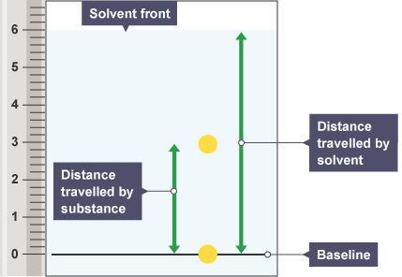
GCSE Knowledge Organiser Unit 2.2 – Plants and Photosynthesis
NUSA
SCIENCE
FIVE – CHROMATOGRAPHY
The chlorophyll and other pigments in plant leaves can be separated and identified by chromatography.
R_{f} values can be used to identify unknown chemicals if they can be compared to a range of reference substances. The R_{f} value is always the same for a particular substance.
The R_{f} value of a spot is calculated using:
R_{f} =
R_{f} values vary from 0 (the substance is not attracted at all to the mobile phase) to 1 (the substance is not attracted at all to the stationary phase).
Chromatography Phases | The different dissolved substances in a mixture are attracted to the two phases in different proportions. This causes them to move at different rates through the paper.
Mobile phase | the solvent that moves through the paper, carrying different substances with it
Stationary phase | which in paper chromatography is the very uniform, absorbent paper
SIX – PLANT DISEASES
Communicable disease | Effects | Control methods
Tobacco mosaic virus | This virus gives a distinctive ‘mosaic’ pattern of discolouration on the leaves, which affects the growth of the plant due to lack of photosynthesis. | removing and destroying infected plants; washing hands and tools after handling infected plants; crop rotation to avoid planting in soil that has been infected for at least two years.
Rose black spot | This fungal disease causes purple or black spots to develop on leaves, which often turn yellow and drop early. It affects the growth of the plant as photosynthesis is reduced. The disease is spread by spores of the fungus that are produced in the black spots. | not planting roses too close together – to allow the air to flow freely around them; avoiding wetting the leaves when watering – wet leaves encourage the fungal disease; cleaning up any infected leaves from the ground round the roses – to avoid spores spreading; using a fungicide to prevent infection – spraying, especially in advance of warm, wet weather.

