Slide 1
Science Revision
Triple and Trilogy

Slide 2
How to revise for Science
Plan
Understand
Learn
Practice

Slide 3
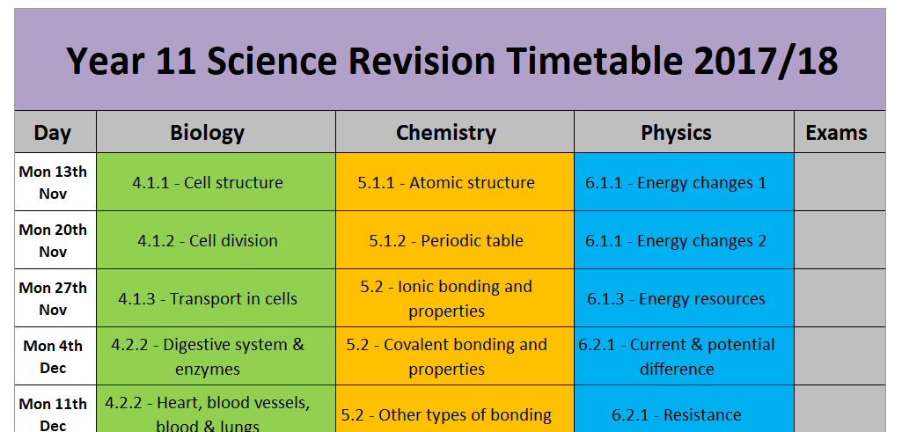
Plan

Slide 4
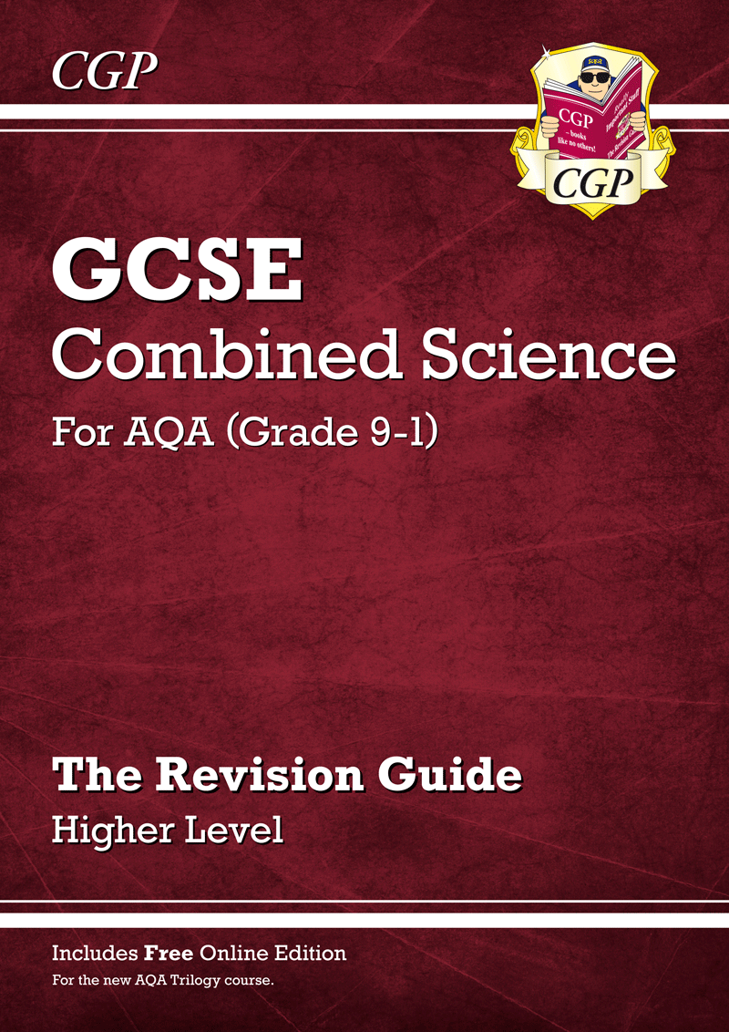
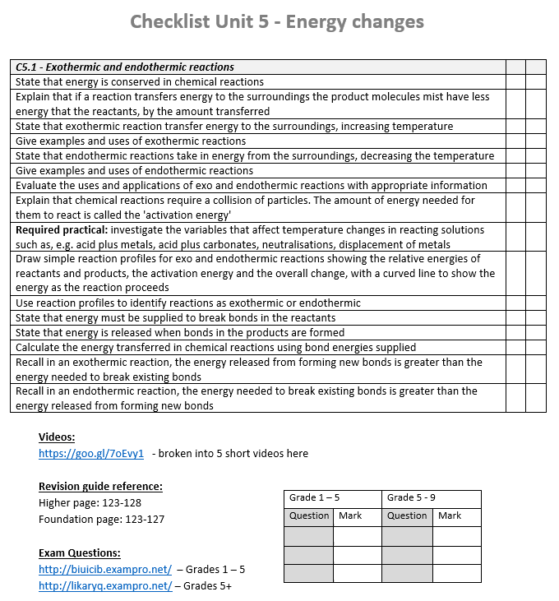
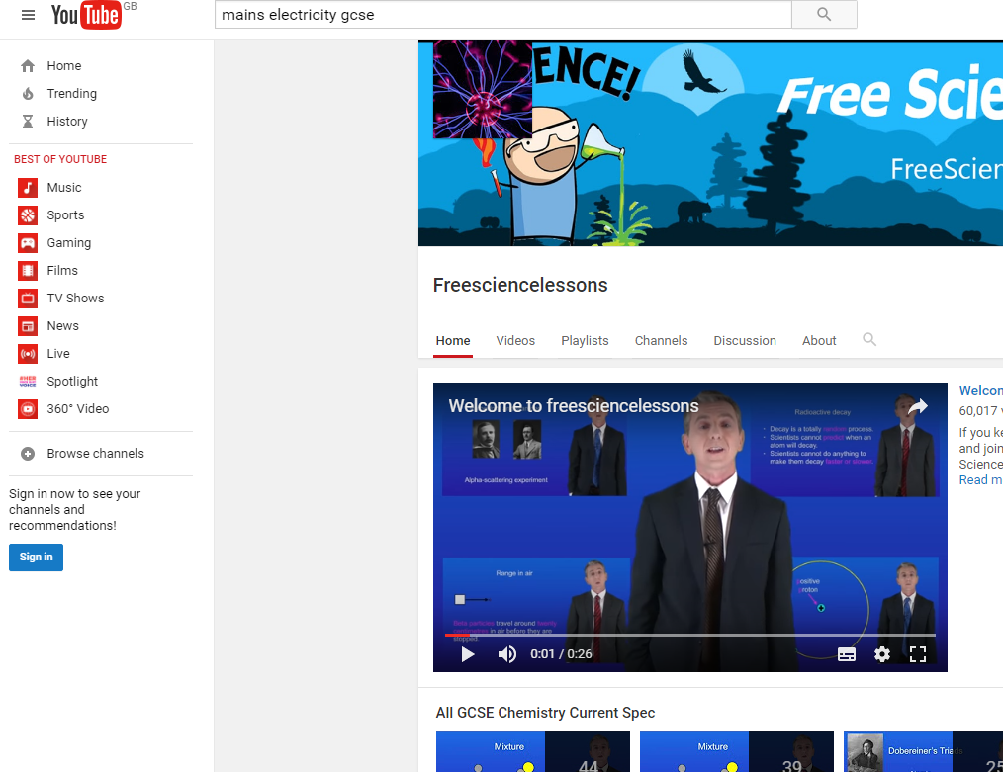
Understand
Use the resources at your disposal to get a good understanding of the content.

Slide 5
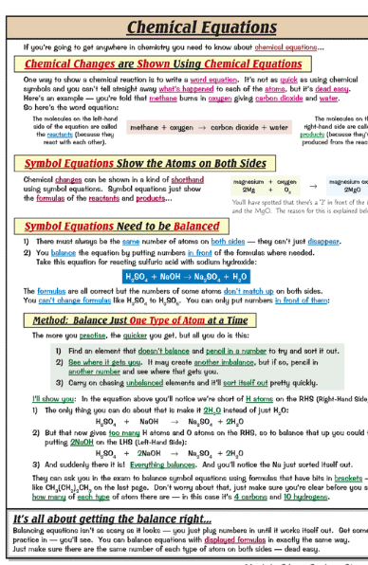
Learn
DO
Spend 15-20 mins reading specification / revision guides / watching videos, to learn the content
Spend 10-20mins re-writing the information until it has committed to memory
Come back to the same topic the day after to see how much you can remember

Slide 6
Learn
DON’T
Spend hours making pristine revision notes/cards and continually re-reading them without testing your memory
Spend 3 hours straight going over something again and again without a break
Learn things that are unnecessary. (check the checklist)
Have your phone in the same room while revising
Think it’s too late to start revising

Slide 7
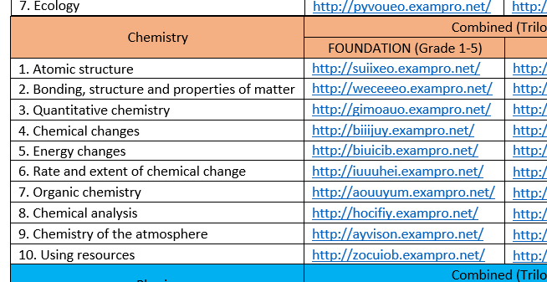
Practice
Keep testing yourself until you are confident you know the content.
Ask people to test you to check you know the stuff
Make flashcards – questions on the front, answers on the back
Keep revisiting it in forthcoming days to check you still remember it
Use practice exam questions and quizzes to check you can apply your learning

Slide 8
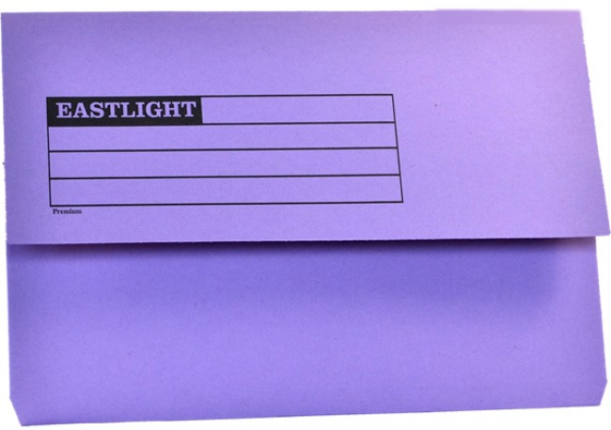
Revision packs

Slide 9
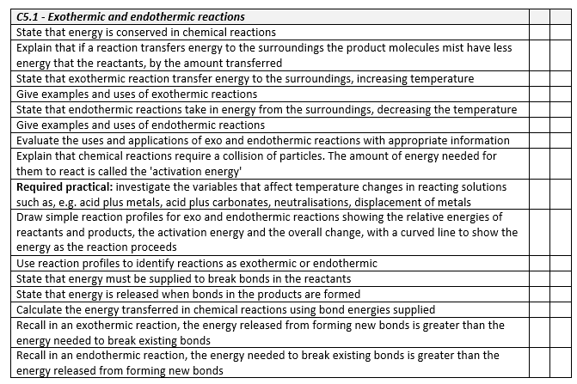
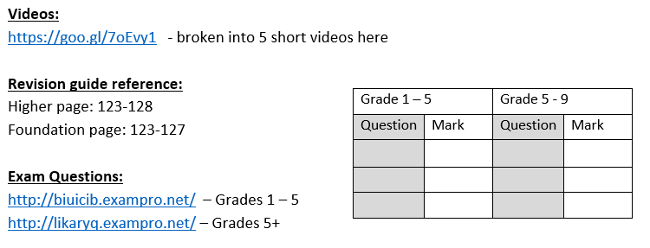
What you have in your packs
Specification checklists

Slide 10
What you have in your packs
Equation sheet

Slide 11
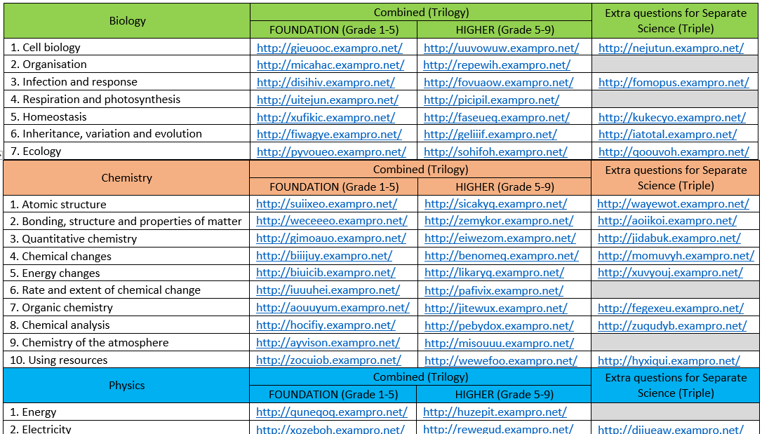
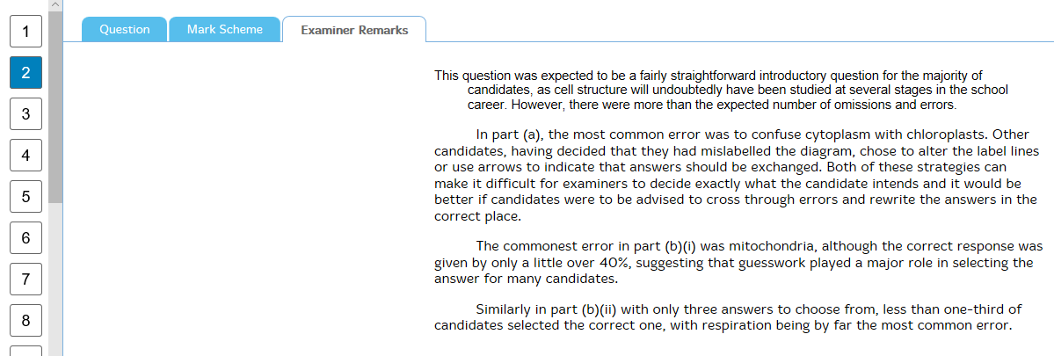
What you have in your packs
Links to lots of exam questions

Slide 12
Key revision aids
https://www.youtube.com/freesciencelessons – short videos on all topics
http://www.gojimo.com/
CGP revision guides

Slide 13
How to revise for Science
Plan
Understand
Learn
Practice

