Slide 1
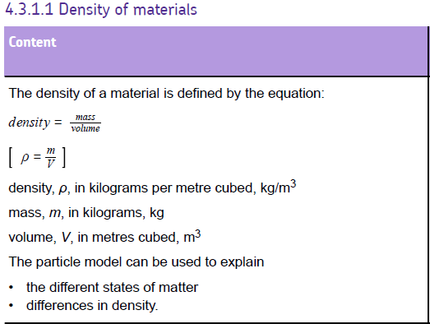
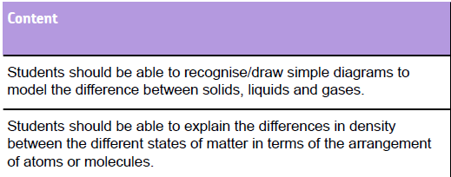

Slide 2


What is Density?
If you take the same volume of different substances, then they will weigh different amounts.
Wood
Water
Iron
1 cm³
1 cm³
1 cm³
0.50 g
1.00 g
8.00 g
Q) Which has the greatest mass and therefore the most dense?
Density is the Mass per unit Volume

Slide 3
Density Equation
g or kg
Density =
Mass
Volume
m
g/cm³ or kg/m³
cm³ or m³
ρ
V
= m
V
Example:
Q) Liquid water has a volume of 250cm³, while ice has a volume of 272cm³.
Calculate the density of each if the mass of each object is 250kg.
ρ = m = 250 = 1.0g/cm³ V 250
ρ = m = 250 = 0.92g/cm³ V 272

Slide 4
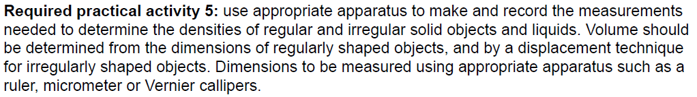
Density required practical

Slide 5
DENSITY OF A REGULAR SOLID
Find the mass of the solid on a balance.
Measure the three lengths and calculate the Volume.
(i.e V = l x w x h )
Calculate the Density.
m = 240 g
2.0 cm
3.0 cm
4.0 cm
ρ = m = 240 =10.0 g/cm³
V 24

Slide 6
DENSITY OF A LIQUID
Resolution = smallest measurement that can be made with measuring instrument
= m
V
Measure the mass of an empty measuring cylinder
Pour the liquid into a measuring cylinder
Measure and record the volume with the liquid in
Measure and record the mass with the water in
Subtract the mass of the empty measuring cylinder away from the total
Calculate the density
Material | Mass before | Mass after | Difference | Volume | Density (m/v)

Slide 7
DENSITY OF AN IRREGULAR SOLID
use a measuring cylinder to find the Volume.
Find the mass of the solid on a balance.
Add the object to the measuring cylinder.
Calculate the water that is displaced.
Calculate density
m = 440 g
40.0 cm³
ρ = m = 440 =11.0 g/cm3
V 40

Slide 8
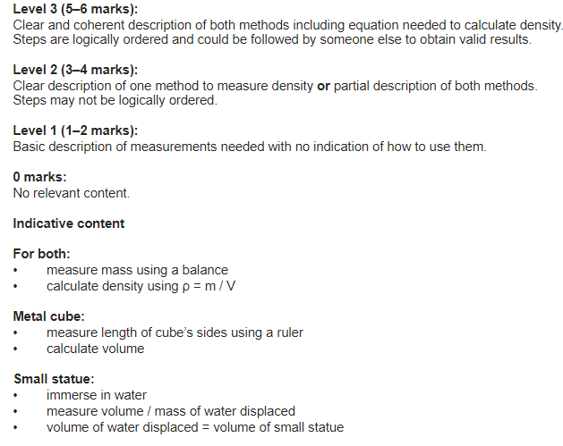
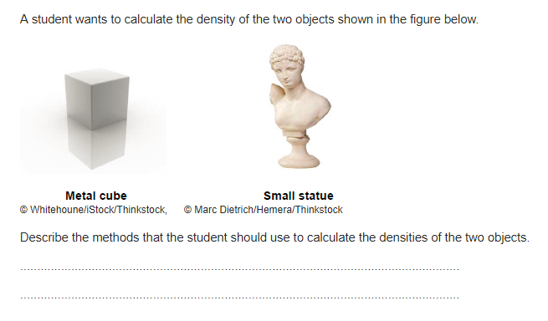

Slide 9
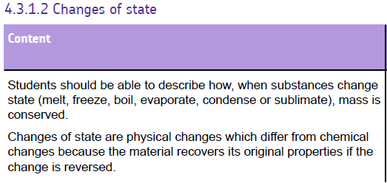

Slide 10
Kinetic Theory
In kinetic theory, all matter is made of tiny particles, which are constantly moving. In this model the temperature is related to the average kinetic energy of these particles. The higher the average kinetic energy, the higher the temperature. Transferring heat is simply transferring kinetic energy of particles.

Slide 11
Kinetic Theory
Particles in a solid vibrate about fixed positions so a solid keeps its shape. Particles closely packed together with high forces of attraction between particles
Particles in a liquid are in contact, but move about at random. It doesn’t keep it’s shape and flows. It has a fixed volume
Particles in a gas move about randomly, at different speeds. They are far apart, and fill the container they are in.

Slide 12
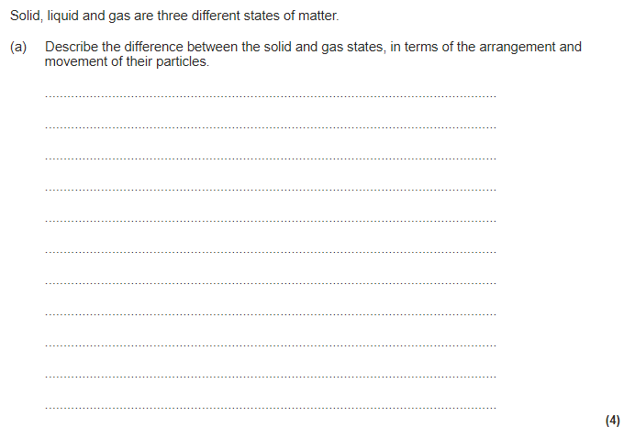
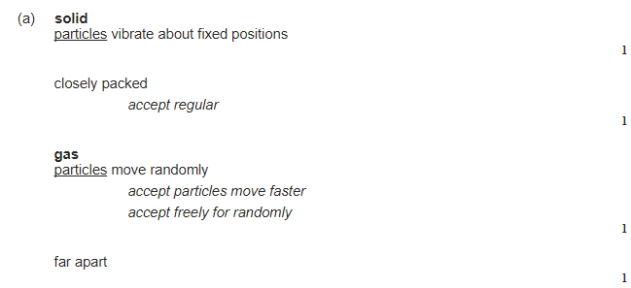

Slide 13
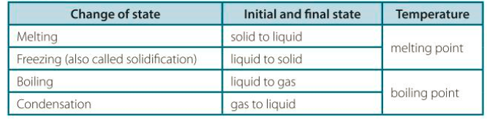
Changes of state
FREEZING POINT
CONDENSING POINT
COOLING
SOLID
LIQUID
GAS
HEATING
MELTING POINT
BOILING POINT

Slide 14
Heating curve
What is happening to the kinetic energy of the particles when the temperature is increasing?

Slide 15
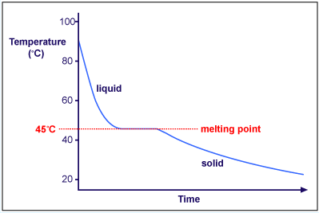
Cooling curve
What is happening to the kinetic energy of the particles when the temperature is decreasing?
What is happening to the kinetic energy of the particles when the substance reaches it’s melting point?
How do we know the melting point of this substance?
What state is this substance at room temperature (21⁰C)

Slide 16
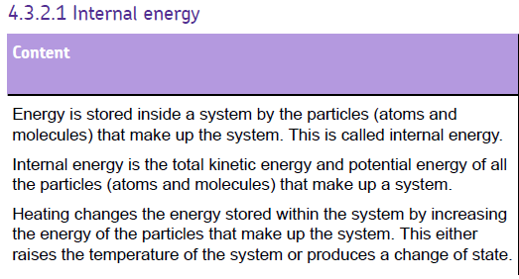

Slide 17
Internal Energy
Internal energy: the energy stored by the particles of a substance
The internal energy of a substance is the sum of:
The kinetic energy the particles have
The potential energy the particles have (relative to each other)
Internal Energy
Total kinetic energy
Total potential energy

Slide 18
Heating curve – which part of internal energy is increasing at each stage?
Think about kinetic theory…!
Kinetic energy?
Potential energy?

Slide 19
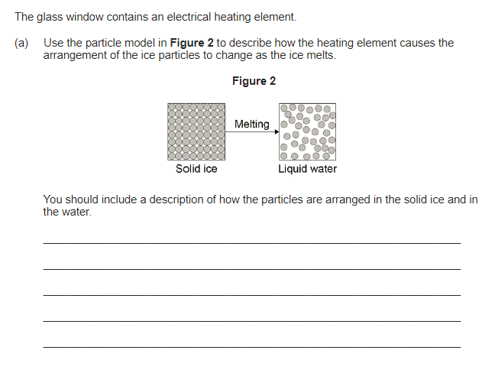
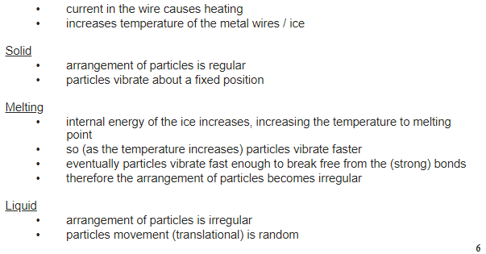

Slide 20
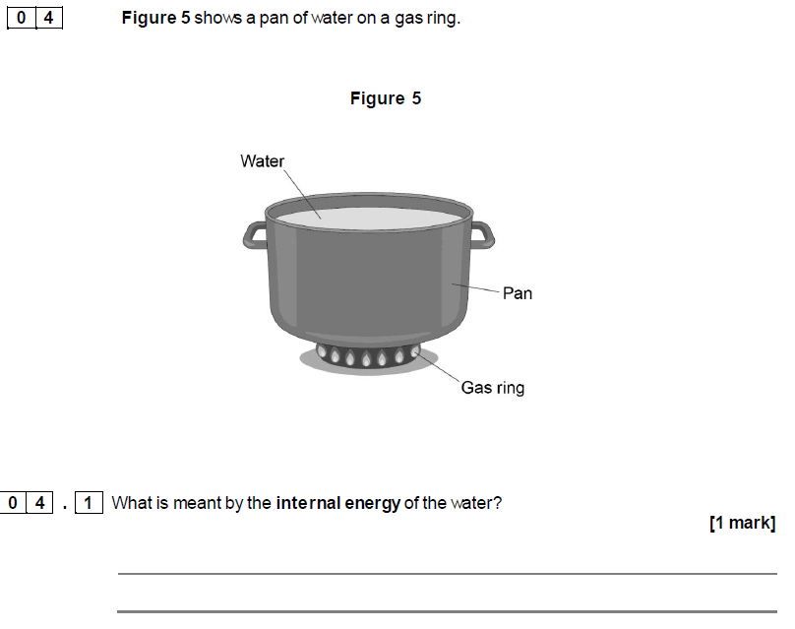


Slide 21
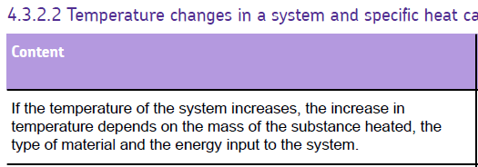
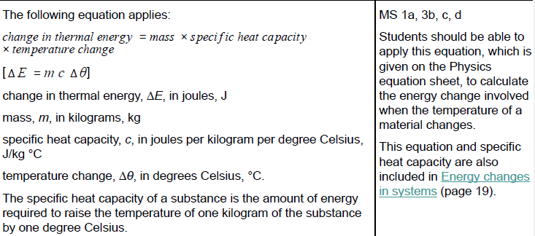

Slide 22
Specific Heat Capacity
The SHC is the amount of energy needed to increase the temperature of 1kg of a material by 1ºC
Energy transferred (E) = mass × specific heat capacity × ∆temperature
E = energy (J)
m= mass (kg)
c = specific heat capacity (J/kg˚C)
∆t = change in temperature (˚C)
Can you rearrange the equation to get c (specific heat capacity) on its own?
E
m x c x ∆t

Slide 23
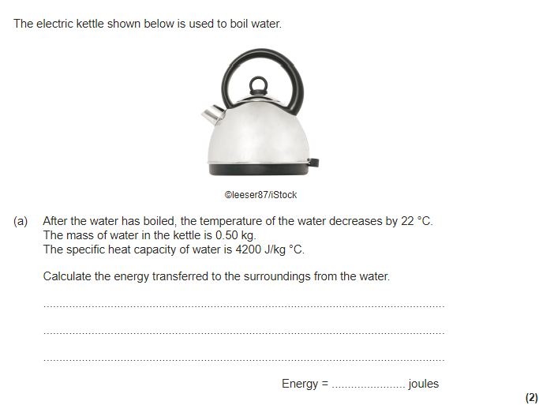
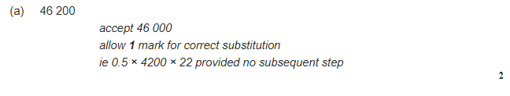

Slide 24
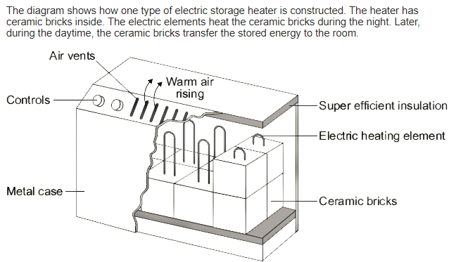
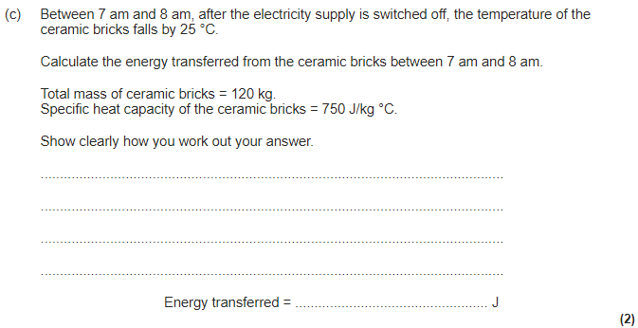
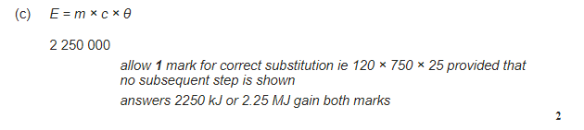

Slide 25
Specific heat capacity
Sketch this graph. The line plotted is for a substance with a specific heat capacity of 500 J/kg˚C.
What would the line look like for a substance with a SHC of 4200 J/kg˚C if the amount of energy provided and mass of the substance was the same
What about a substance with a SHC of 250 J/kg˚C
The gradient for the substance with a SHC of 4200 J/kg˚C has got a shallower gradient than the substance with a SHC of 250 J/kg˚C.
The red substance has a higher specific heat capacity which means that it needs more energy to raise it’s temperature by one degree. Therefore if they are being supplied the same amount of energy, the red substance will show a slower rate of temperature change than the green substance.
250 J/kg˚C
500 J/kg˚C
Temp (˚C)
4200 J/kg˚C
Time (mins)
Exam question: The same amount of energy is supplied to three different substances with the same mass. Compare the gradients of the red and green substance and suggest why the gradient is different for each substance.

Slide 26
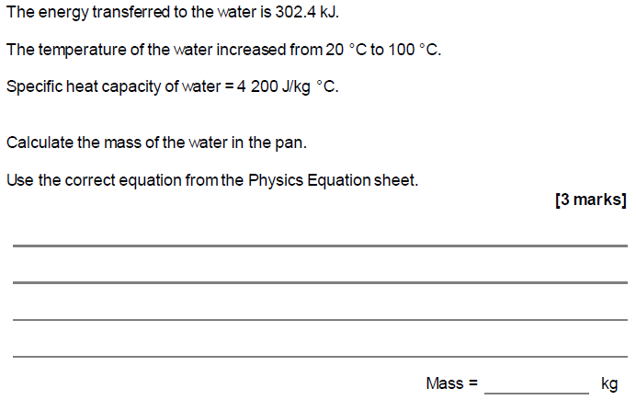
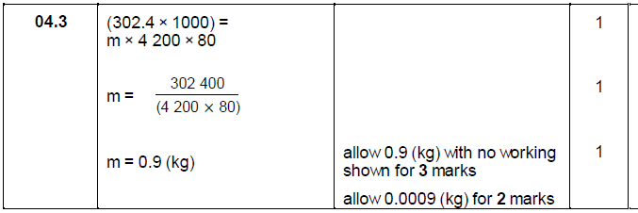

Slide 27
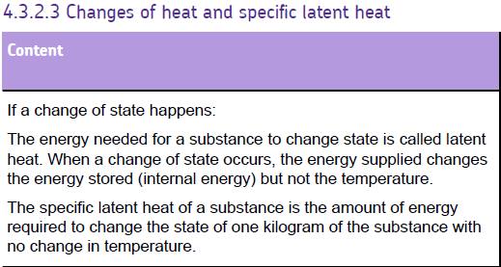
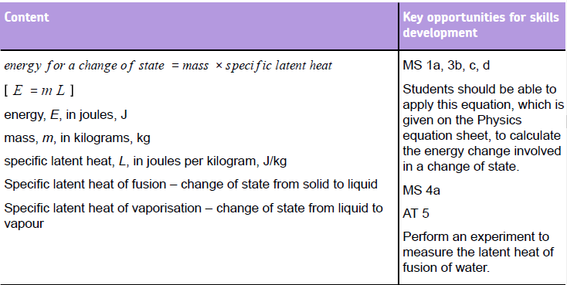
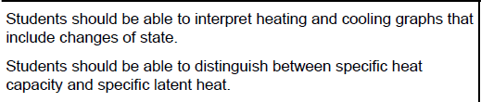

Slide 28
Specific Latent heat
The specific latent heat of a substance tells us how much energy is needed to change the state of 1 kg of substance at constant temperature.
Specific latent heat of fusion is Solid to liquid or liquid to solid
so melting or solidifying
Specific latent heat of vaporisation is liquid to gas or gas to liquid
So evaporation or condensing

Slide 29
Remember Specific Latent heat is -
The energy needed to change the state of a substance without increasing its temperature.
Thermal energy is needed to break the bonds or separate the molecules.
liquid
Specific latent heat of fusion
Temp (°C)
Melting point
solid
Time (mins)

Slide 30
Specific Latent Heat
Energy = mass x specific latent heat
E = mL
J kg J/kg
This equation will be on your physics sheet so you don’t need to memorise it

Slide 31
Heating curve – what is happening at each stage?
Used to measure specific heat capacity (how much energy it takes to raise the temperature of a substance)
Specific latent heat of vaporisation (how much energy does it take to completely boil a substance)
Specific latent heat of fusion (how much energy does it take to melt a substance)

Slide 32
Practice questions
Define specific latent heat.
Calculate the energy needed to melt 0.49kg of aluminium . The specific latent heat of fusion of aluminium is 399,000 J/kg.
If the specific latent heat of vaporisation of aluminium is 10,500,000 J/kg, find the energy needed to vaporise 0.49kg of aluminium.
Find the specific latent heat of fusion of element Y if 405,000J of energy are used to melt 0.6kg of the element.

Slide 33
Answers
The specific latent heat of a material is the energy absorbed or released when 1kg of the material changes state without a change in temperature
195,510J.
5,145,000J
675,000J/kg

Slide 34
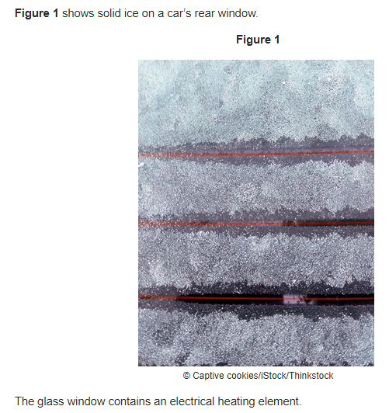
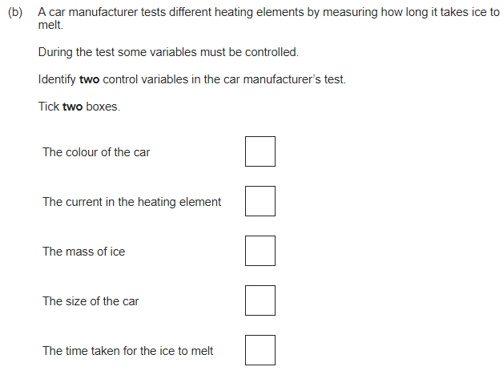


Slide 35
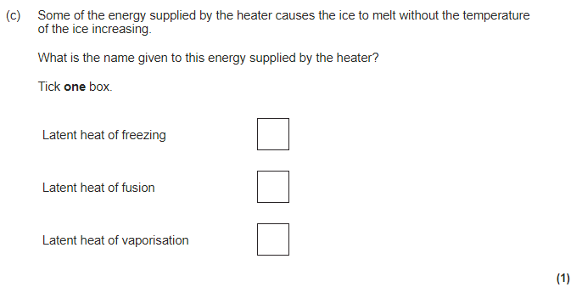

Slide 36
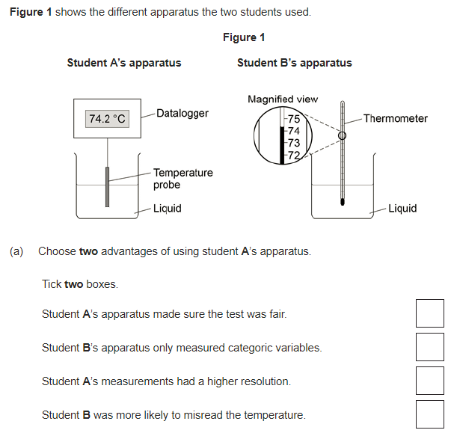
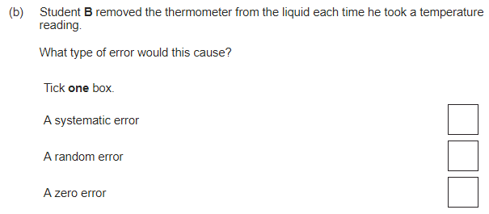
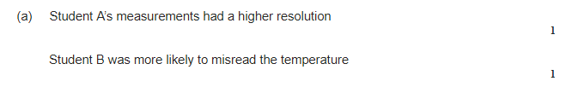

Slide 37
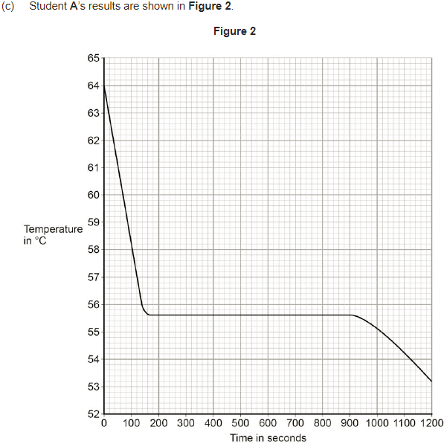
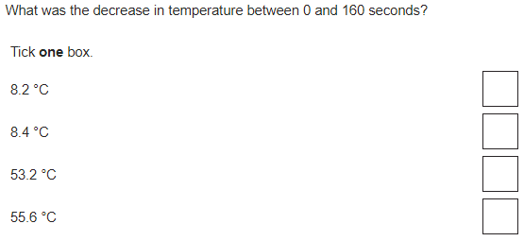
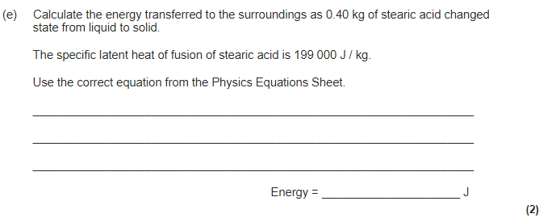
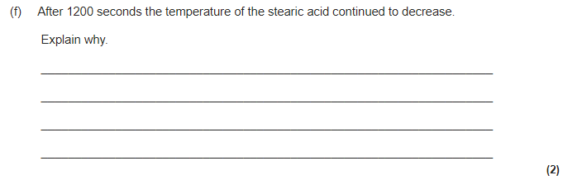
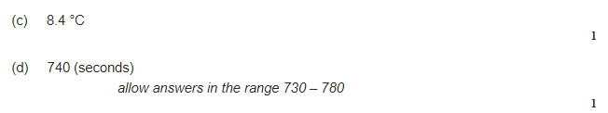
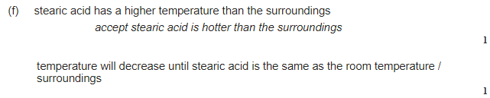
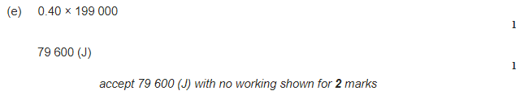


Slide 38
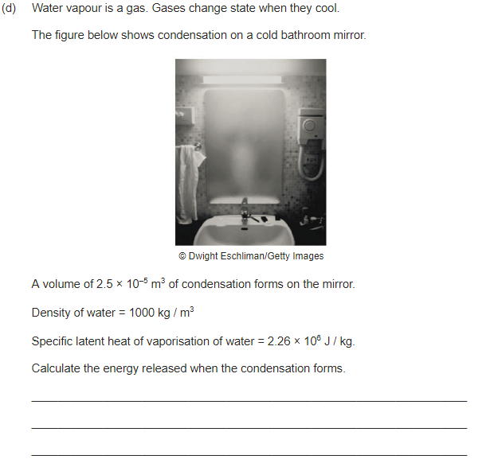
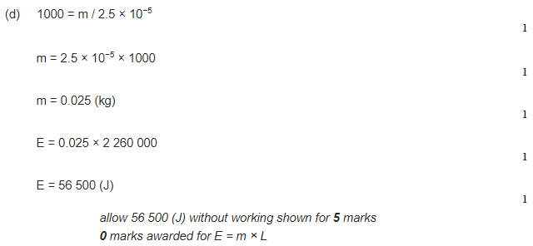

Slide 39
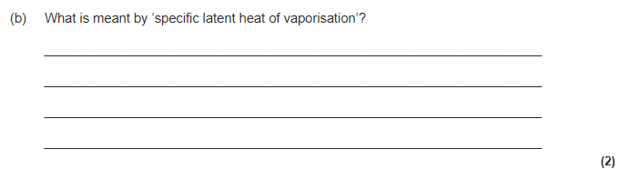
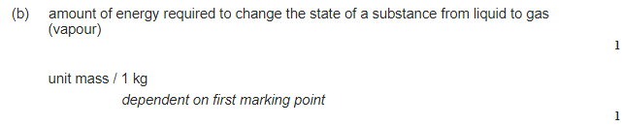

Slide 40
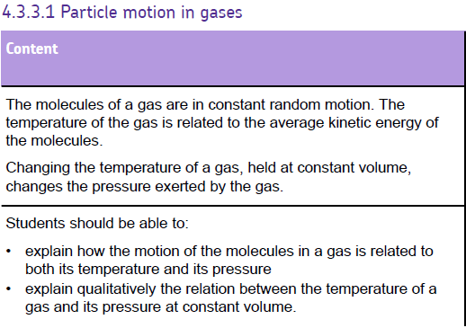

Slide 41
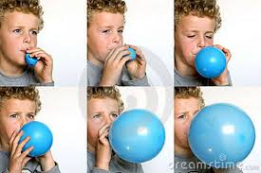
What is pressure?
Key words: Pressure, force, applied, Pascal, atmospheric
Gas pressure is cause when particles inside a container, collide repeatedly with each other and the surface. Each impact with the surface exerts a tiny force on the surface. The total force of all the particles colliding on a unit area of the surface is ‘gas pressure’.
It can be increased by increasing the kinetic energy of the particles (by heating)

Slide 42
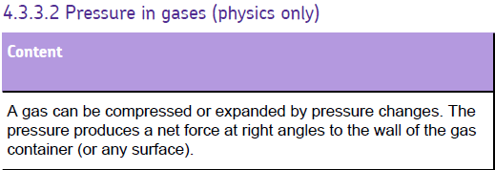
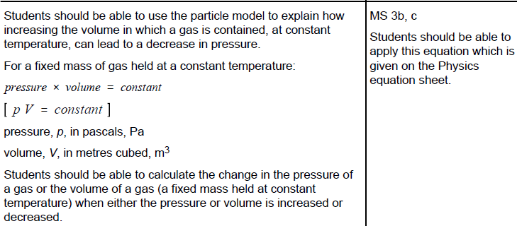
This will be given to you in the exam (on the equation sheet)

Slide 43
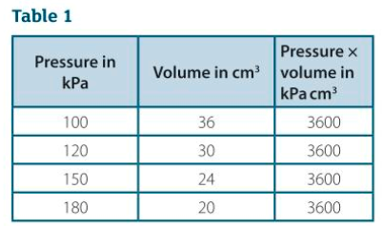
Pressure in gases
For a fixed mas of gas, the number of gas molecules is constant.
If the volume of a fixed mass of gas at constant temperature is reduced, the gas pressure increases because:
The space the molecules move in is smaller so they don’t travel as far between each impact with the surface of their container
The molecules hit the surfaces more often, so the number of impacts per second increases. So the total force of the impacts per square metre of surface area (the pressure) increases.

Slide 44
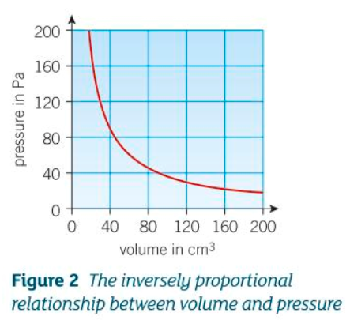
Boyle’s law
constant = pV can be rearranged to
P = constant
V
When this is rearranged is shows that pressure is inversely proportional to the volume of the gas. Therefore if the volume is doubled, the pressure will be halved.

Slide 45
