Slide 1
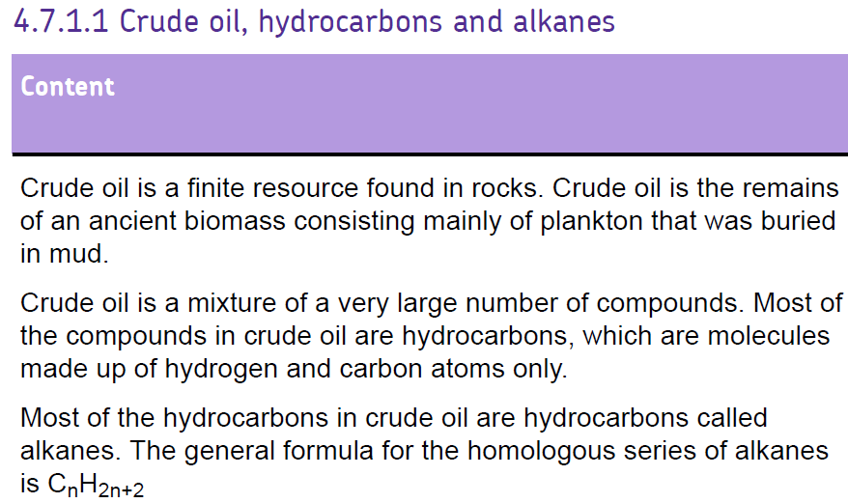
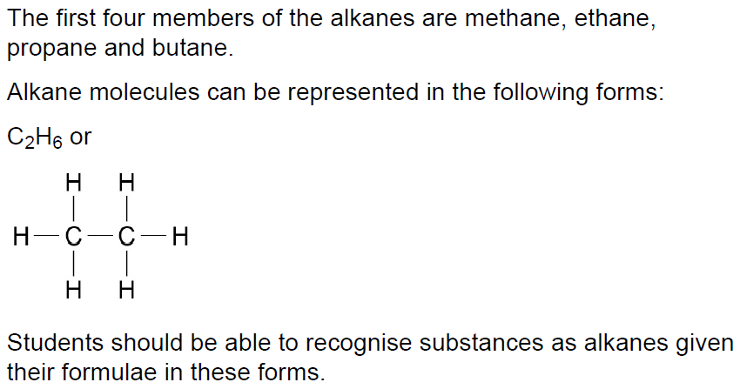

Slide 2


Slide 3
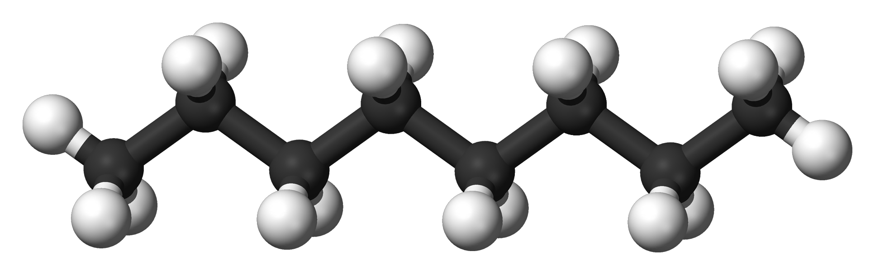
Hydrocarbons
Oil is a mixture of HYDROCARBONS
Most of the compounds in crude oil consist of molecules made up of hydrogen and carbon atoms only.
We can separate the different unchanged hydrocarbons from crude oil by FRACTIONAL DISTILLATION.

Slide 4
Alkanes
Alkanes are the name of a type of chemical that makes up the compounds in crude oil.
They are hydrocarbons (contain only hydrogen and carbon) and form a series of increasing molecular weights.

Slide 5
Carbon chains
Alkanes are chains of carbon atoms with hydrogen atoms attached to them.
There is an alkane with one carbon atom, two carbon atoms, three, four, five and so on. The chains can be massive with hundreds of carbon atoms.
You need be able to name and draw the first four and recognize some larger ones.

Slide 6
Alkanes
We can work out a general formula for any alkane it is:
C_{n}H_{2n+2}
where n is the number of carbon atoms
and 2n+2 is the number of hydrogen atoms

Slide 7
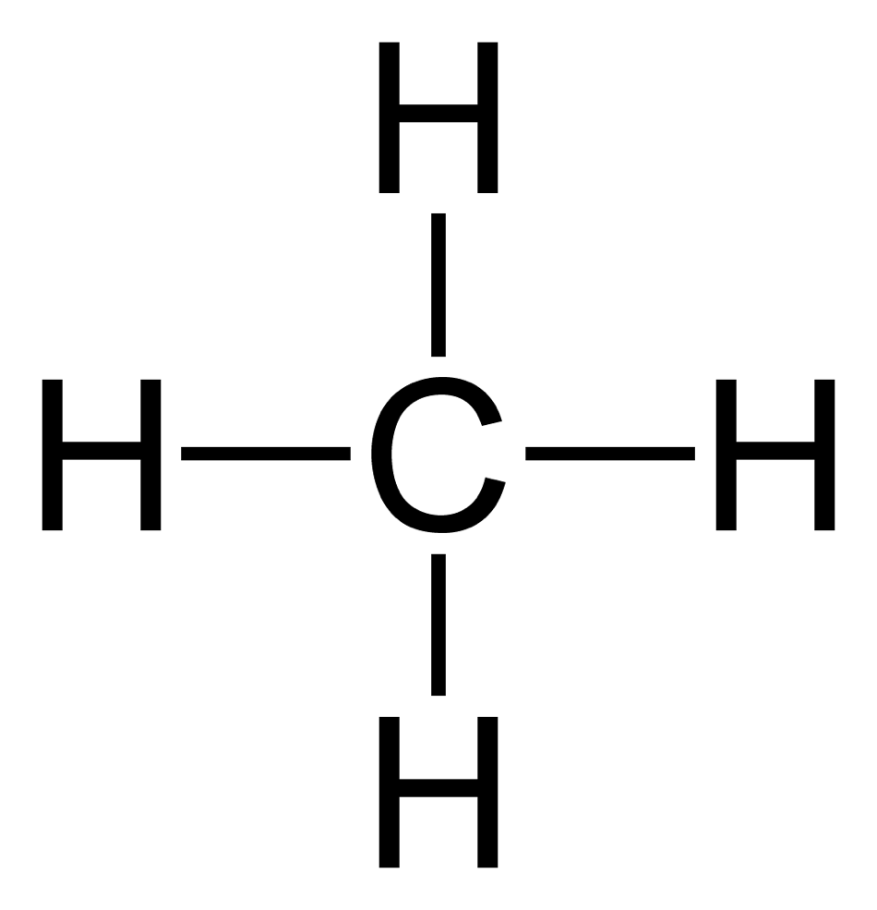
Methane
One carbon atom bonded to four hydrogen atoms.
Each line represents a single covalent bond.
Structural formula
Molecular formula
CH₄

Slide 8
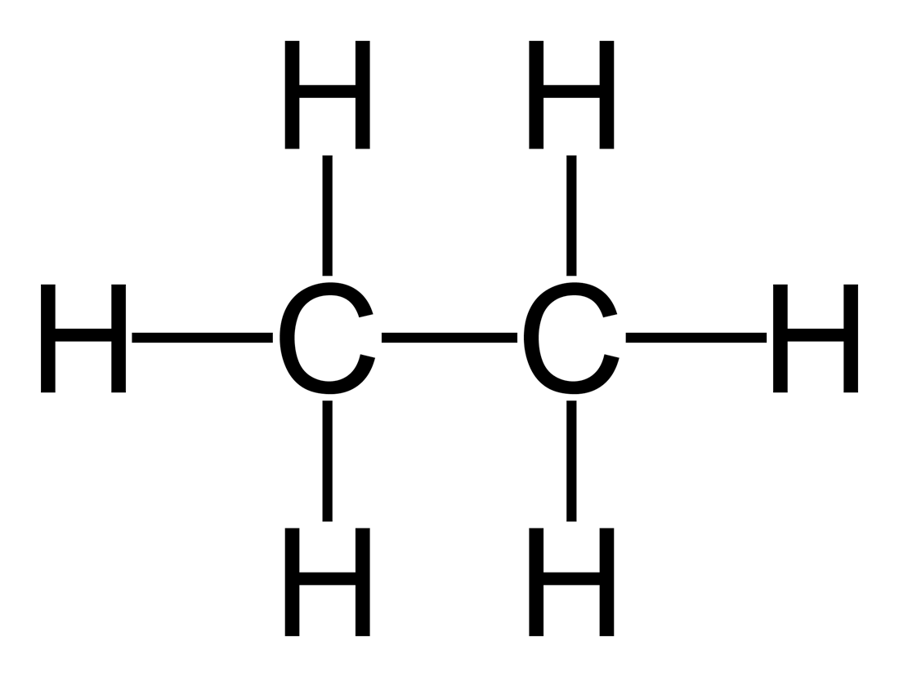
Ethane
Two carbon atoms six hydrogen atoms
Structural formula
Molecular formula
C₂H₆

Slide 9
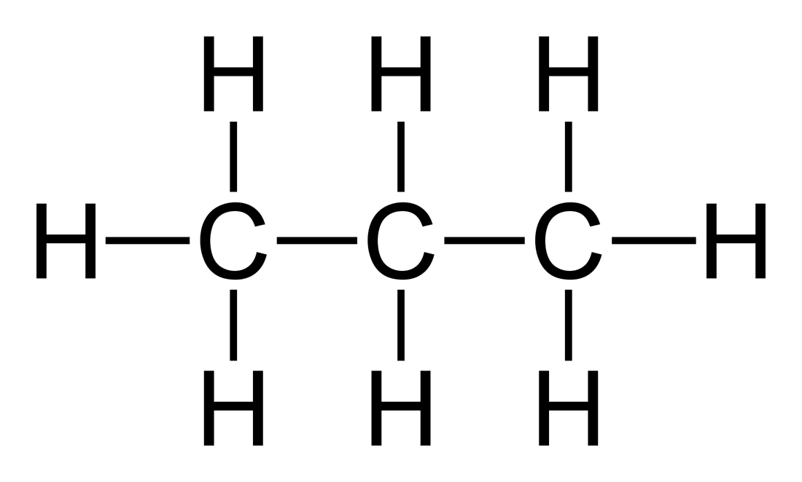
Propane
Three carbon atoms eight hydrogen atoms
Structural formula
Molecular formula
C₃H₈

Slide 10
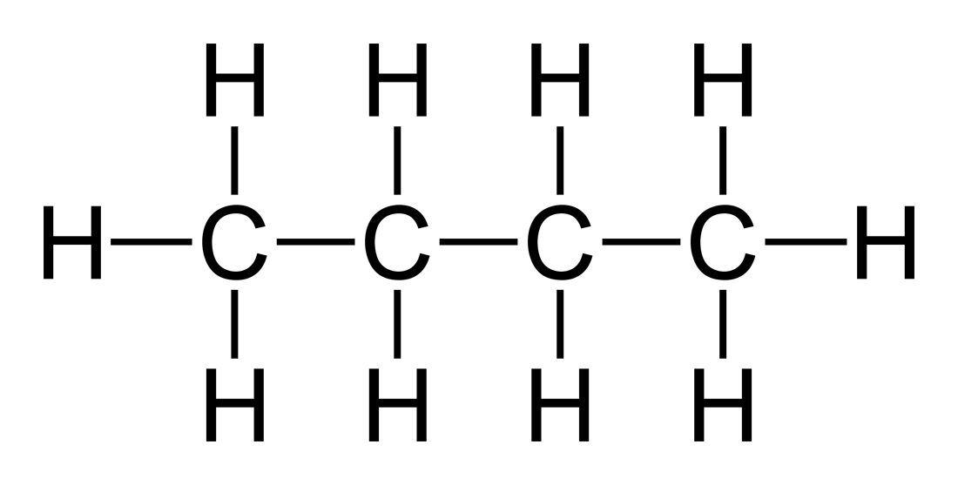
Butane
Four carbon atoms ten hydrogen atoms
Structural formula
Molecular formula
C₄H₁₀

Slide 11
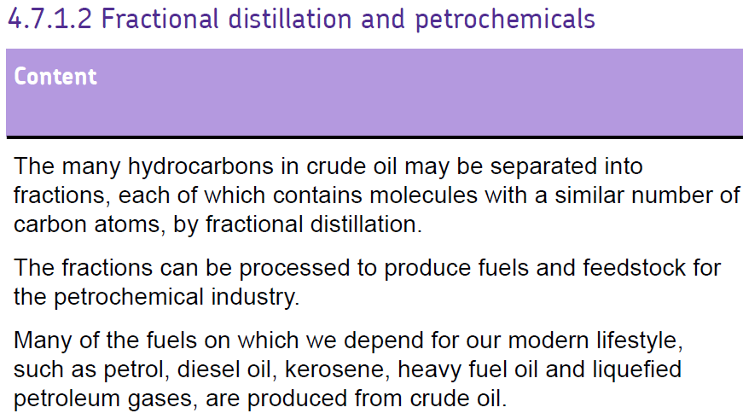
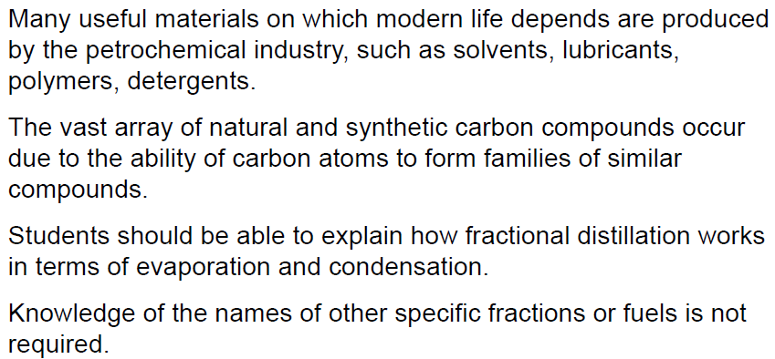

Slide 13
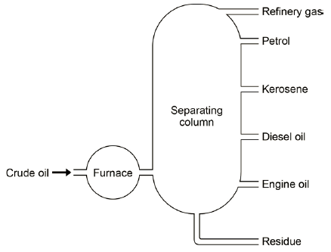
Crude oil is heated
Hydrocarbons evaporate
Fractionating column is hotter at the bottom / cooler at the top
Vapours condense at their boiling points / at different levels.
LOW boiling points
CONDENSE
HEAT
EVAPORATE
HIGH boiling points

Slide 14
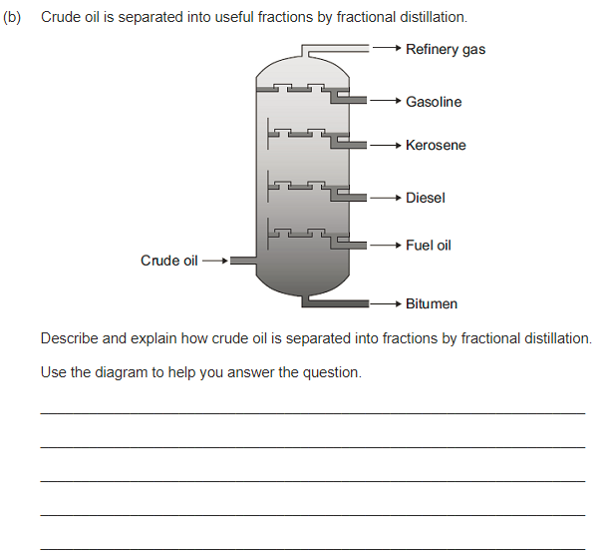
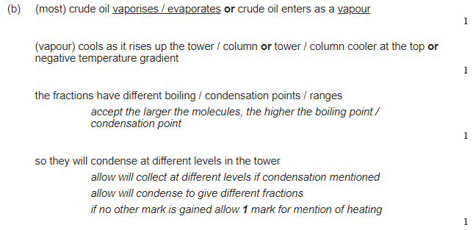

Slide 15
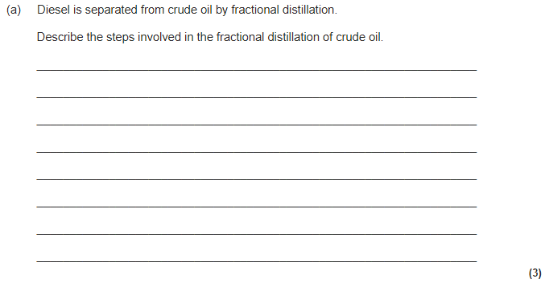
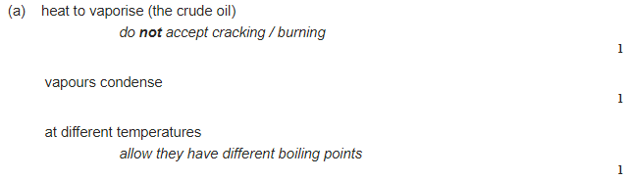

Slide 16
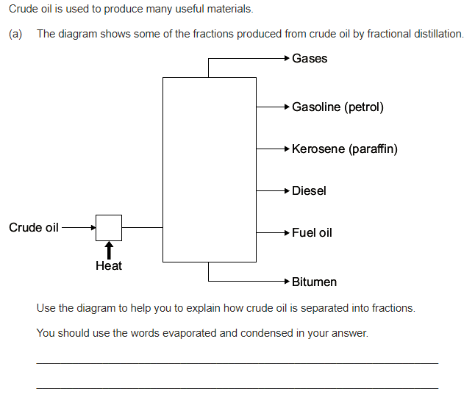
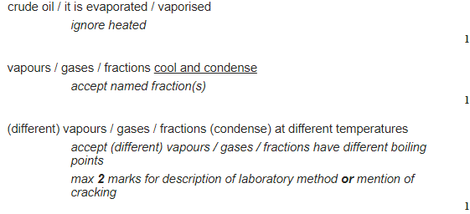

Slide 17
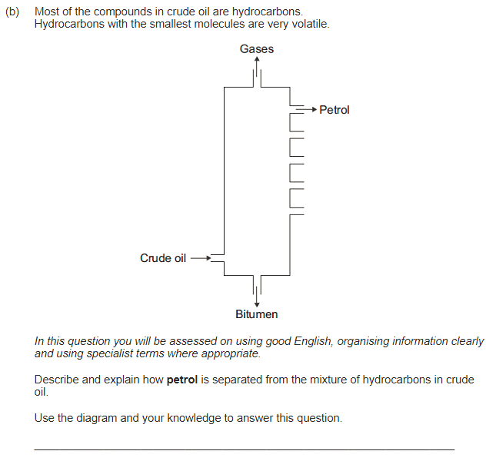
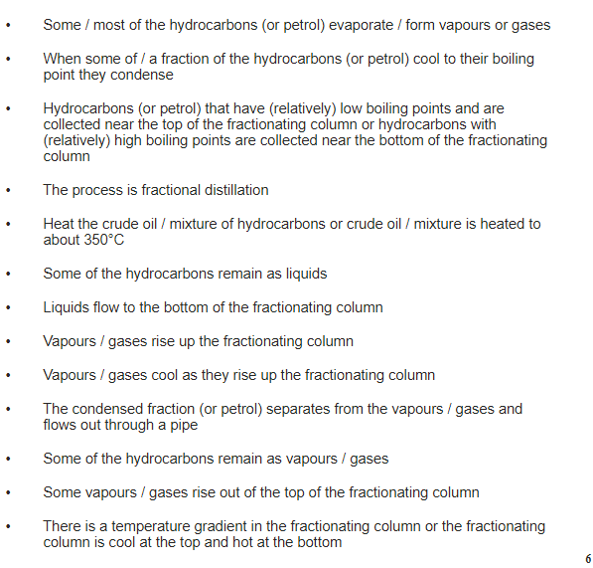

Slide 18
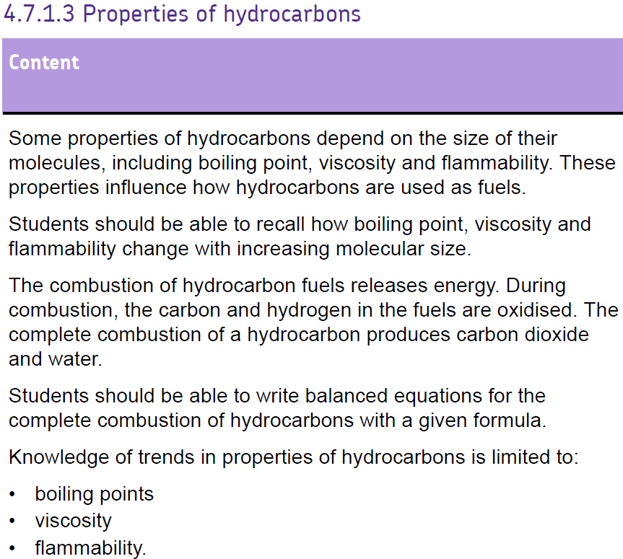

Slide 20
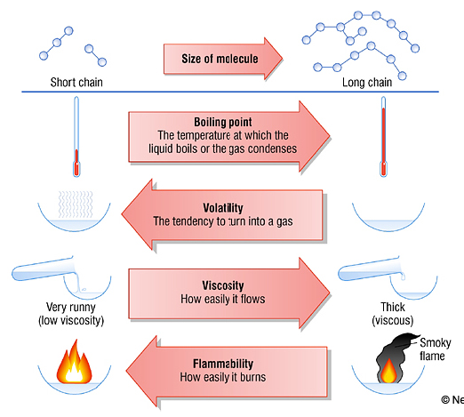
Properties of hydrocarbons
KEY WORDS:
Boiling point:
Volatility:
Viscosity:
Flammability:

Slide 22
Burning hydrocarbons
Complete combustion- With enough oxygen
Carbon dioxide
oxygen
water
Word equation:
Propane + ________ → ________ + ________
Symbol equation:
C₃H₈
5
4
3
O₂
H₂O
CO₂
______ + ________ → ________ + ________
oxidation

Slide 23
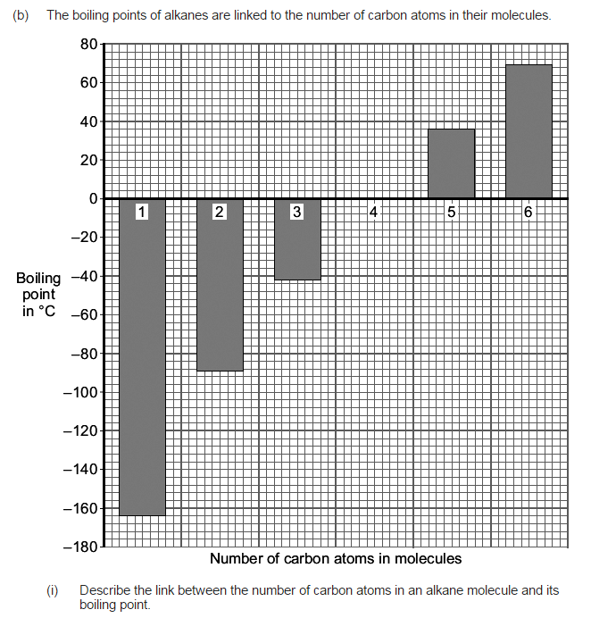
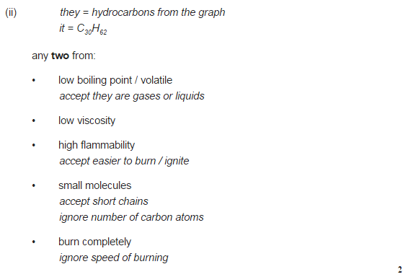
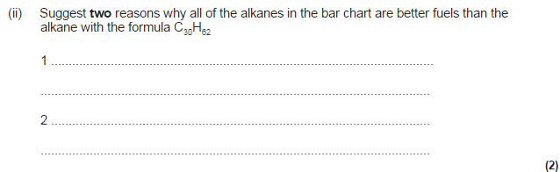
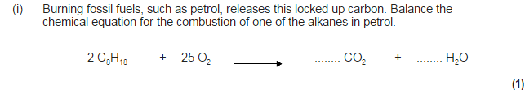

Slide 24
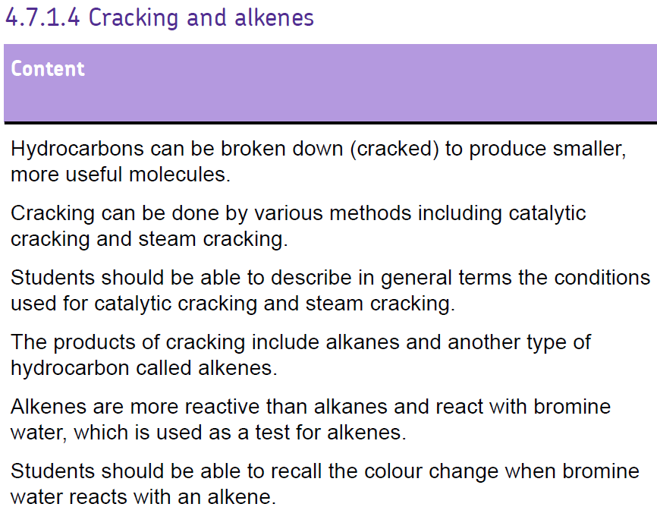
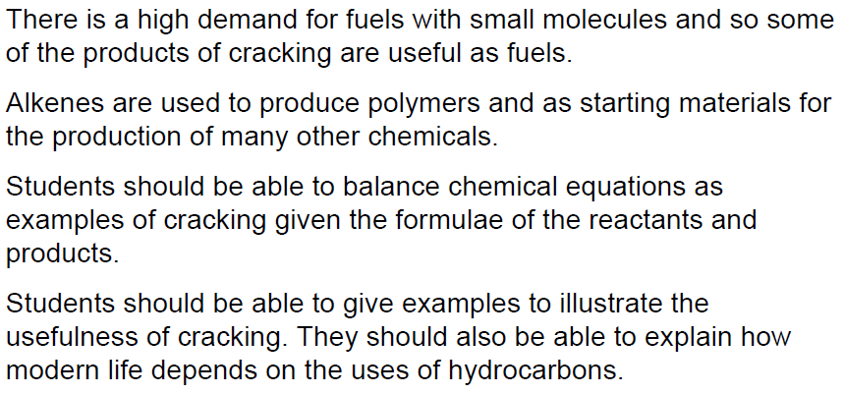

Slide 26
Alkanes: Supply and Demand
Methane gas
Long chains – found in the residue fraction
Octane – found in the petrol fraction
Short chain hydrocarbons are far more in demand than long chain hydrocarbons. We solve this problem by ‘cracking’ long chain hydrocarbons (breaking them into smaller hydrocarbons)

Slide 27
Types of cracking
Steam cracking
  High temperature and pressure
Catalytic cracking
  (Relatively) Low temperature and pressure
  Used in the production of petrol

Slide 28
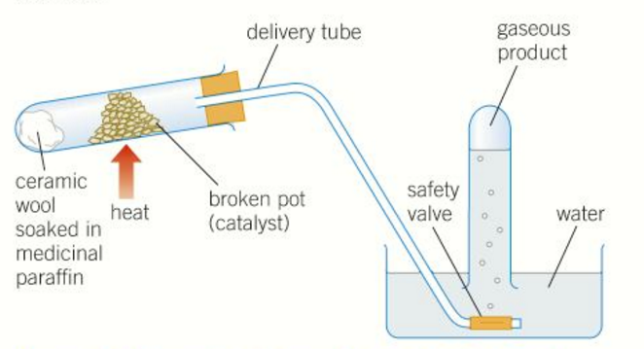
Cracking Apparatus

Slide 30
Catalytic Cracking
In the catalytic cracker long chain molecules are split apart or ‘cracked’. An example of such a reaction is:
This is an example of an alkene. It has at least 1 double bond and has he formula C_{n}H_{2n}
Octane
Heat
pressure
hexane
catalyst
ethene
+
Ethene
is used
to make
plastics
Used as a fuel
C₈H₁₈ ➔ C₆H₁₄ + C₂H₄

Slide 31
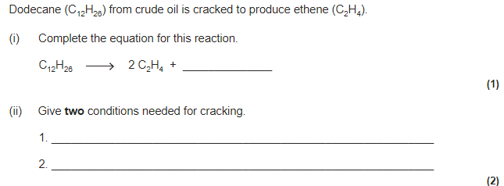
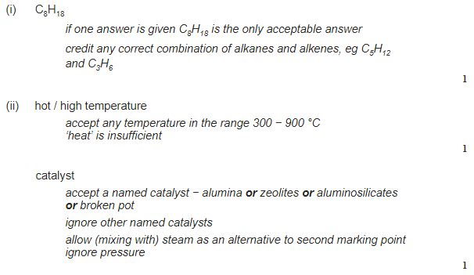

Slide 32
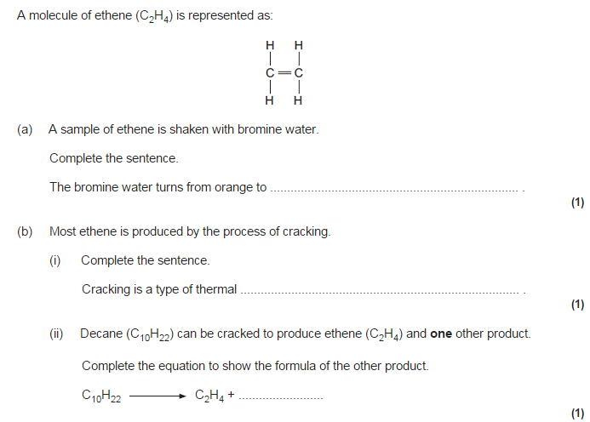
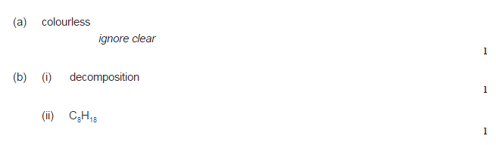

Slide 33
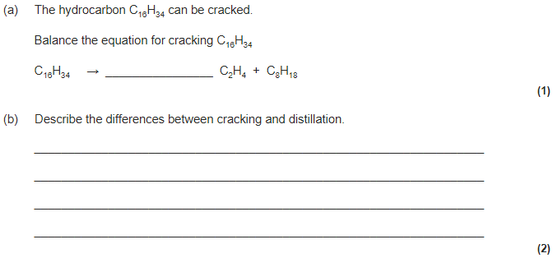
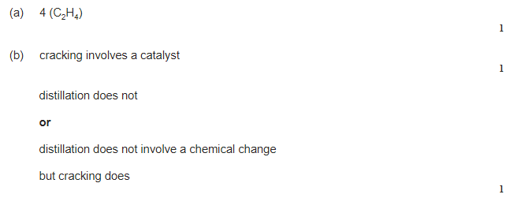

Slide 34
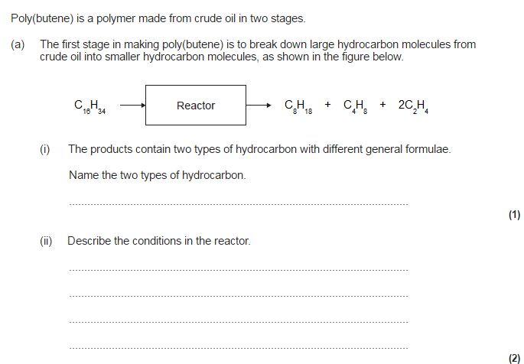
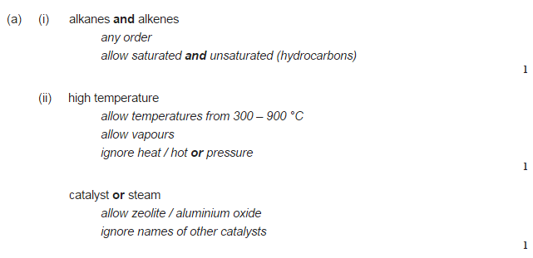

Slide 35
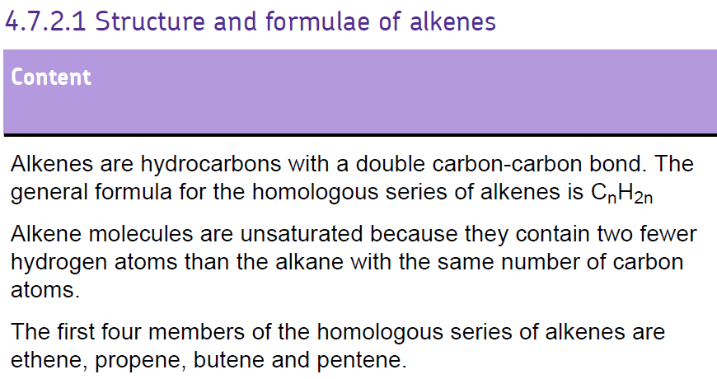
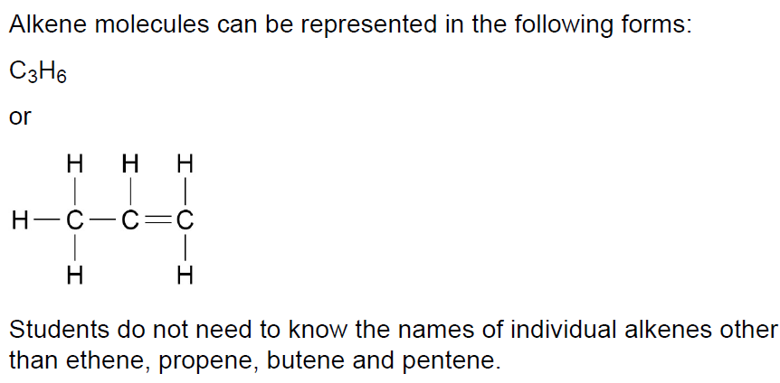

Slide 36
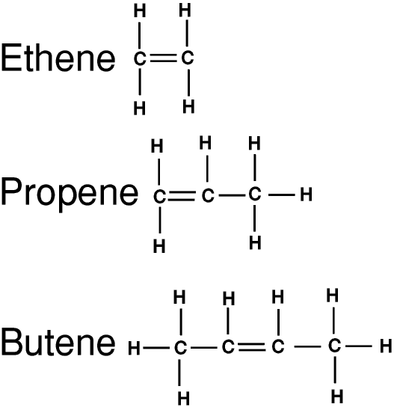
Alkenes structure
Ethene
Propene
Butene
C₂H₄
C₃H₆
C₄H₈

Slide 37
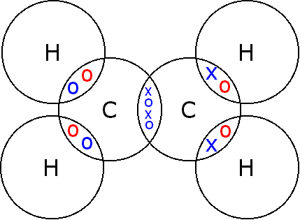
Covalent Bonding in Alkenes

Slide 38
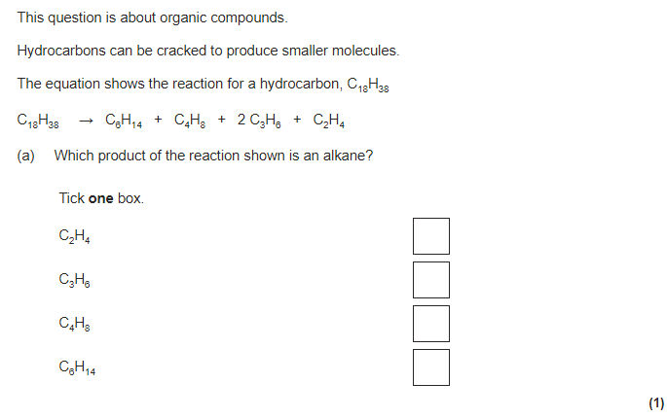

Slide 39
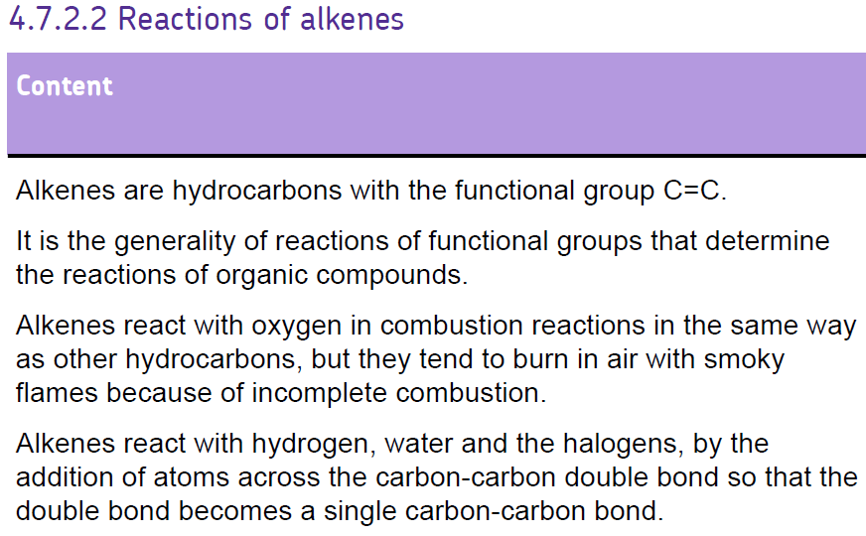
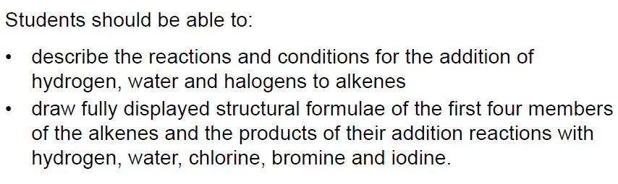

Slide 41
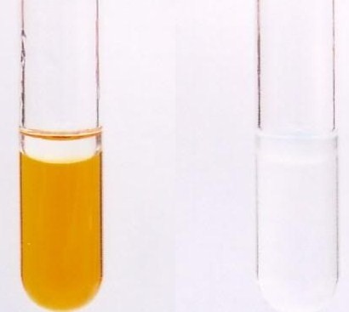
Addition Reactions – Halogens
How do we know halogens and alkenes undergo addition reactions?
  Bromine water turning colourless
Alkane + Bromine water (no reaction)
Alkene + Bromine water (turns colourless)
Alkenes will also react with other halogens:
Chlorine
Bromine
Iodine

Slide 42
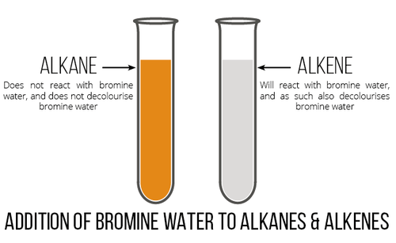
Testing alkenes – using bromine water

Slide 44
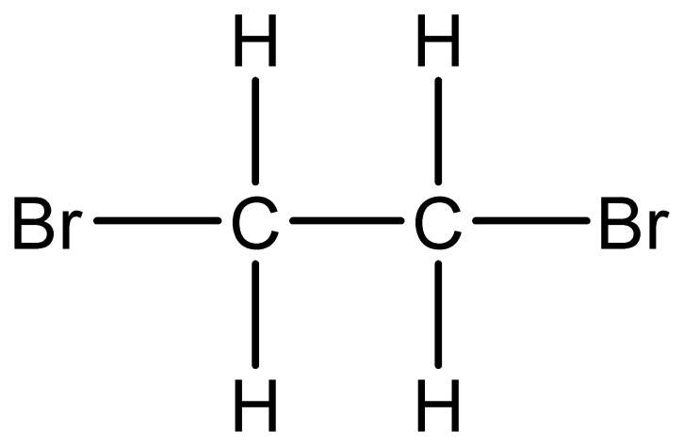
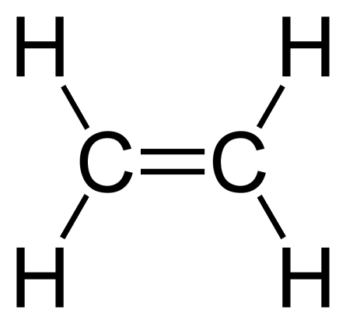
Addition Reactions – Halogens
+
Br
Br
→
Ethene
Bromine
Dibromoethane
Colourless

Slide 45
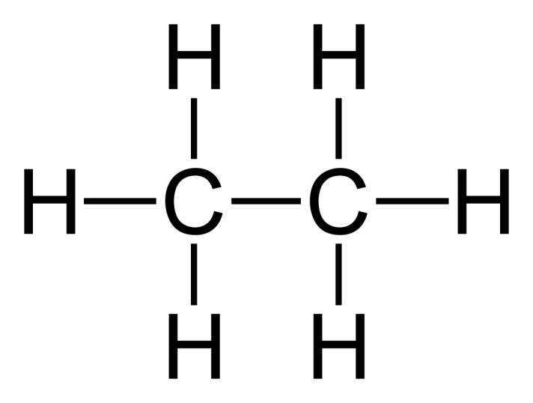
Addition Reactions – Hydrogen
Alkenes are unsaturated so we can add more hydrogen to make them saturated
Hydrogenation
  60⁰C
  Nickel catalyst
+
H
H
→
Ethene
Hydrogen
Ethane

Slide 46
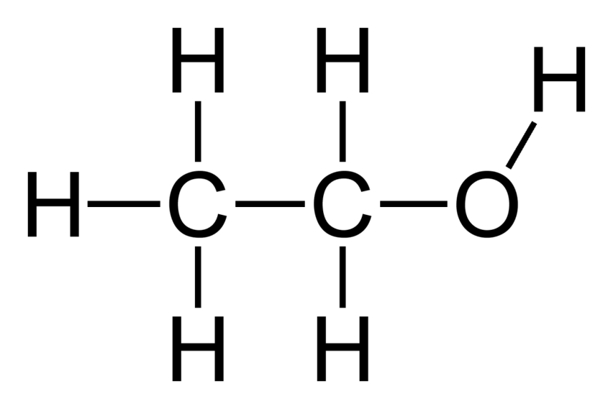
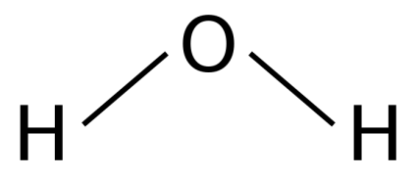
Addition Reactions – Water (Steam)
Ethanol (and other alcohols) can be made from the hydration of ethene (and other alkenes)
Hydration is the addition of water
  Concentrated phosphoric acid catalyst
  High temperature and pressure
+
→
Ethene
Water
Ethanol

Slide 47
Addition Reactions – Water (Steam)
The reaction is reversible so ethanol can break back down into steam and ethene
Unreacted ethene and steam are recycled over the catalyst

Slide 48
All Addition Reactions
In all addition reactions, only one molecule of halogen, hydrogen or water is needed
Only one double bond to open up
Halogens, e.g. Br₂
  One bromine from the bromine molecule bonds to one carbon from the double bond, then the other Br bonds to the other carbon from the double bond
Hydrogen, H₂
  Same concept, but with H-H
Water, H₂O
  H bonds to one of the carbons, then OH bonds to the other
How many hydrogen molecules would I need if I had two double bonds? Why?

Slide 49
Naming
Halogens
  Dibromo (bromine)
  Dichloro (chlorine)
  Diiodo (iodine)
Hydrogenation
  ene to ane
    Ethene to ethane
Hydration
  Will look at naming alcohols in a few lessons time!

Slide 50



Slide 52
Covalent Bonding in Alcohols
Ethanol – CH₃CH₂OH
H
H
H
C
C
O
H
H
H

Slide 53
Production of Ethanol
Ethanol is used commonly in everyday products
There are two ways ethanol is produced industrially
  Hydration of Ethene
  Fermentation of Glucose

Slide 54




Fermentation
1.
2.
3.
Extract sugar (glucose) from crops
Add yeast to glucose (enzymes in yeast act as a catalyst)
Fermentation
  30-40⁰C
  CO₂ released
  Batch process (stop and start)
C₆H₁₂O₆ (aq) → 2CH₃CH₂OH (aq) + 2CO₂ (g)
Glucose → Ethanol + Carbon dioxide

Slide 55
Advantages/Disadvantages
Advantages
Disadvantages
Sugars – renewable resource
Batch process – cheap equipment needed
More carbon neutral
Very slow
Very impure – needs further processing, fractional distillation, which takes time and money
Batch process – high labour costs

Slide 56




Hydration of Ethene
1.
2.
3.
Extract crude oil from the ground
Oil refinery – fractional distillation then cracking to get ethene
Hydration (addition of steam)
  Phosphoric acid catalyst
  High temperature and pressure
  Continuous process
C₂H₄ + H₂O → CH₃CH₂OH
Ethene + Water → Ethanol

Slide 57
Advantages/Disadvantages
Advantages
Disadvantages
Fast reaction
Pure product
95% yield (initially 5%, can recycle unreacted ethene)
Continuous (cheaper manpower)
High technology equipment needed – expensive initial costs
High energy costs for high pressure
Ethene is non-renewable

Slide 59
Reactions of alcohol
State the products in the following reactions:
Ethanol + Oxygen → Carbon dioxide + water
Ethanol + Oxidising agent → Ethanoic acid + water
Ethanol + Sodium → Sodium ethoxide + hydrogen
What would you observe in each of the reactions above?

Slide 60



Slide 62
Carboxylic Acids
The properties of carboxylic acids are due to the presence of the functional group -COOH
O
H
C
O
H
Methanoic Acid, HCOOH
C_{n}H_{2n+1}COOH

Slide 63

Carboxylic acids
2 carbons - Butanoic acid.
3 carbons - Pentanoic acid
4 carbons - Ethanoic acid
5 carbons - Propanoic acid
Ethanoic acid

Slide 64


Carboxylic acids properties
Form acidic solutions when dissolved in water
Less acidic than nitric and hydrochloric acid
Unpleasant smells and tastes
  Responsible for smelly socks and rancid butter
Normally have higher boiling points than water
Not Flammable

Slide 65
Reacting Carboxylic Acids
Carboxylic acids show the characteristic reactions of acids with metals, alkalis and carbonates
Carboxylic acids react with:
Metals to form a salt and hydrogen (slowly)
Carbonates to form a salt, water and carbon dioxide
Alkalis to form salt and water (neutralisation)

Slide 66
As weak acids
Acids must dissolve in water to show their acidic properties, as in water all acids ionise
Strong acids completely ionise in solution
Weak acids only some will ionise in solution
In two samples of equal volume, the strong acid will have a higher concentration of H⁺ (aq)
HCOOH (aq) + H₂O(l) → H₃O⁺(aq) + HCOO⁻(aq)
Methanoic Acid Base Oxonium Ion Methanoate Ion

Slide 67

Making Esters
Carboxylic Acids reacting with alcohols
Water is formed in the reversible reaction
Sulphuric acid is normally used as a catalyst
Strong Acid Catalyst
Carboxylic acid + Alcohol Ester + Water
Ethanoic Acid + Methanol Methyl Ethanoate + Water

Slide 68

Naming Esters
First part from the alcohol
Second part from the acid
From the alcohol (propanol)
From the acid (Ethanoic Acid)
Propyl Ethanoate

Slide 69
Properties of Esters
Volatile (evaporate easily)
Sweet/ Fruity smelling (Used in perfumes and food flavourings)

Slide 70


✓
✓

Slide 71



Slide 73

Polymerisation
So what is a POLYMER?
Polymers are two or more …………………. bonded together!
Monomers

Slide 74
Polymerisation
Draw the polymer that was produced from this alkene.

Slide 75
Same elements in same places
No double bond
Lines outside of the brackets
n on right hand side

Slide 76



Slide 77




Slide 79
Condensation Polymerisation
The difference between addition and condensation polymerisation?
Addition polymerisation → the addition polymer
Condensation polymerisation → the condensation polymer
+ a small molecule
In plastics industry, monomers used for condensation polymerisation contain two different functional groups which will react together
Usually water (H₂O) or hydrogen chloride (HCl)

Slide 80
Condensation Polymerisation
Forming a polyester
How do we produce an ester?
Which 2 functional groups are required?
(an alcohol containing 2 OH functional groups)
This is how we would represent a diol
HO – CH₂ – CH₂ – OH can be written as HO – – OH

Slide 81
Condensation Polymerisation
Forming a polyester
(an alcohol containing 2 OH functional groups)
This is how we would represent a diol
HO – CH₂ – CH₂ – OH can be written as HO – – OH
(ethanediol)
(an carboxylic acid containing 2 COOH functional groups)
This is how we would represent a dicarboxylic acid
HOOC – CH₂ – CH₂ – COOH can be written as HOOC – – COOH
(ethanedioc acid)

Slide 82
Condensation Polymerisation
Forming a polyester
Polyesters are formed from the condensation (water produced) of a diol and a dicarboxylic acid
_{n}HO – CH₂ – CH₂ – OH +
_{n}HOOC – CH₂ – CH₂– CH₂ – CH₂ – COOH
( CH₂ – CH₂ – OOC – CH₂ – CH₂ – CH₂ – CH₂ – COO )_{n}
+ H₂O

Slide 83


Slide 85


Slide 87

Natural Polymers
Glucose and fructose are monosaccharides (monomers), made up of one sugar unit
Glucose + Fructose Sucrose (+H₂O)
Condensation polymerisation

Slide 88
Natural Polymers
Monosaccharides can also form polymers known as polysaccharides, made up of thousands of sugar monomers
Glucose monomers starch polymers (+H₂O)
Glucose monomers cellulose polymers (+H₂O)
What do plants use this starch and cellulose for?
Condensation polymerisation
Condensation polymerisation

Slide 89
Natural Polymers
Proteins are also natural polymers!!!
amino acid monomers protein polymers (+H₂O)
Condensation polymerisation

Slide 90




Functional group #1
Functional group #2
Basic Group
Acidic Group
Glycine (simplest amino acid)
Peptide links
H
H
O
H
O
H
O
N
C
C
N
C
C
N
C
C
H₂O
H
H
H
H
H
O
H

Slide 91


Slide 92


Slide 93



