Slide 1
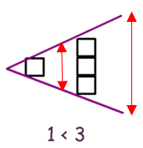
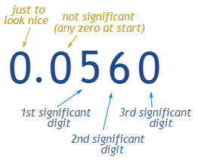
Year 7 KLC 1
Knowledge Organiser Year 7 Knowledge Learning Check 1
Half Term 1
Ordering Numbers
Representing Inequalities
1. Increasing in size
Keywords
Ascending - from smallest to biggest
Descending – from biggest to smallest
Inequalities can be read in two ways.
Notice the small number is on the small side and big number on the big side.
This says, “ 1 is smaller than 3” and “3 is bigger than 1”
Example – Write the following in ascending order of size
Representing Inequalities on a Number line
2. We need to compare place value
3.Looking at the tenths column, the decimal with the smallest tenths is the smallest.
4.If they have the same value for that place value, compare the next place value.
We can see that we need all the numbers from 1 and smaller.
x < 1 or 1 > x
A closed circle means your it equal to -4 also.
-4 ≤ x < -1
ANSWERS : 0.08 , 0.2 , 0.25 , 0.68 , 0.81
Rounding Place Value
Significant Figures
How?
Simply identify the place value required
Check the next place value to see if it is under or over half way
If its under half way round down if it is over half way round up.
Significant (adjective) : sufficiently great or important to be worthy of attention, noteworthy
The 8 is in the hundreds column
The 4 is in the 1st decimal place
Example
Round 7850 to 1 significant figure.
Example 1
Round 47865
to the nearest 100
There is a 6 in the tens column which is over half way
Example 2
Round 18.4399
to 1 decimal place
The 1st significant figure is the 7 which is in the thousands column so we must round to the nearest 1000
Answer
7000 (1sf)
Answer
47900
Answer
18.4 (1dp)
There is a 3 in the next decimal place

Slide 2
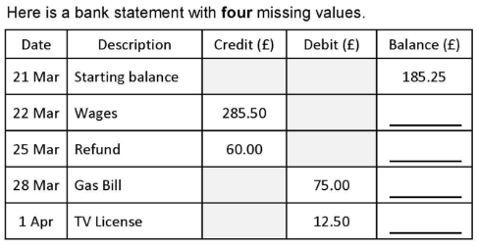
Year 7 KLC 2
Knowledge Organiser Year 7 Knowledge Learning Check 2
Half Term 1
Adding Decimals
Subtracting Decimals
Important
When using the column method we must have the numbers in the right place value.
Important
When using the column method we must have the numbers in the right place value.
Line up decimal
Tip fill in missing place values with zero
Need to borrow
Tip fill in missing place values with zero
Example
Work out 34.7 + 5.61
ANSWER : 40.31
Example
Work out 34.7 - 5.61
ANSWER : 40.31
3 4 . 7 0
1
6
1
3 4 . 7 0
2
Simply add each place value starting with the smallest (right)
+ 5 . 6 1
Simply subtract each place value borrowing if needed.
- 5 . 6 1
4 0 . 3 1
2 9 . 0 9
1
1
Carry the 1
Line up decimal
Negative Numbers
Bank Statements
The amount in your bank
Maths is all about patterns.
If when you add a positive number it gets bigger then when you add a negative number it will get smaller.
Whatever happens with positive numbers the opposite will happen with negative, so…
Added to your account
£470.75
1. When you add a positive it gets bigger, when you add a negative it gets smaller.
2. When you subtract a positive it gets smaller so when you subtract a negative it gets bigger.
£530.75
£455.75
£443.75
Taken out of you account (subtracted)

Slide 3
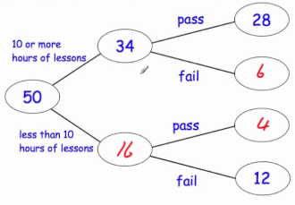
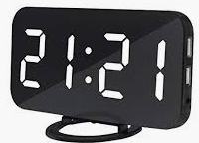
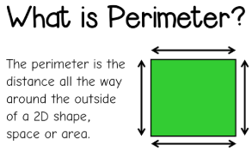
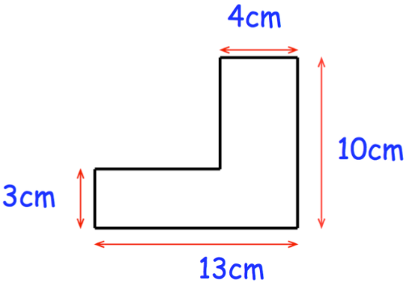
Year 7 KLC 2
Knowledge Organiser Year 7 Knowledge Learning Check 2
Half Term 1
Time
Frequency Trees
Key Conversions
1 Year = 365 days (unless a leap year)
1 month = roughly 4 weeks
52 weeks in a year
60 seconds in a minute
60 minutes in an hour.
Shows what the number represents
24hr Clock Digital
Add to 34
21 hours which is 9 above 12AM
21 minutes
9:21 PM
Have to add to the connected on the left
Example
Add to 16
3 x 50 minute = 150 minutes
2 hours 30 minutes
Perimeter
Compound Shapes
What is a compound shape?
A compound shape is a shape made up of two or more basic shapes.
This length will be the horizontal 13cm – 4cm = 9cm
10cm – 3cm = 7cm
The perimeter is the distance all the way around the 2D shape.
7cm + 4cm + 10cm + 13cm + 3cm = 46cm

Slide 4
Year 7 KLC 3
Knowledge Organiser Year 7 Knowledge Learning Check 3
Half Term 1
Box Method
23 x 14
Column Method
5274 ÷ 3
20 3
Multiply by 4
10
4
2 3
Bus Stop method
1
7
5
8
200 | 30
80 | 12
Multiply by 10
x 1 4
2
1
2
1
3 | 5 | 2 | 7 | 4
9
2
230 + 92
= 322
0
3 goes into 5 once with 2 left over
+
3
Add answers
2
3 goes into 22 7 times with 1 left over
3 goes into 17 5 times with 2 left over
3 goes into 24 8 times
1
3 2 2
Multiplying by Powers of 10
Dividing by Powers of 10
Multiplying by 10 simply shifts the pace value 1 greater.
Dividing by 10 simply shifts the pace value 1 smaller.
Notice that initially we had 3 hundreds but when we multiply by 10 we now have 3 thousands. The same has happened to every place value.
Notice that initially we had 3 hundreds but when we divide by 10 we now have 3 tens. The same has happened to every place value.
352 x 10 = 3520
352 ÷ 10 = 35.2
The 2 tenths have shifted twice to become 2 tens now as we have multiplied by 100 which is the same as x 10 and x 10 again.
The 2 tens have shifted twice to become 2 tenths now as we have divided by 100 which is the same as ÷ 10 and ÷ 10 again.
5.267 x 100 = 526.7
526.7 ÷ 100 = 5.267

Slide 5
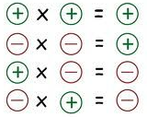
Year 7 KLC 3
Knowledge Organiser Year 7 Knowledge Learning Check 3
Half Term 1
Decimal Multiplication
Decimal Division
2.3 x 0.14
52.74 ÷ 0.3
Multiply by 10 until we have two integers
x10
X10 x10
X10 x10
23 x 14
We need to multiply until the divisor is an integer
To keep it equivalent we need to multiply the dividend also
527.4 ÷ 3
We now need to divide to get back to what we had originally
23 x 14 = 322
Work out as usual
÷10
÷10
÷10
We can now use the bus stop as usual
2.3 x 0.14 = 0.322
527.4 ÷ 3 = 175.8
Multiplying Negatives
Dividing Negatives
Maths is all about patterns.
6 x 7 = 42
6 x -7 = -42
-6 x 7 = -42
-6 x -7 = 42
Multiplication and Division are commutative so the same rules apply.
÷
÷
÷
÷

