Slide 1
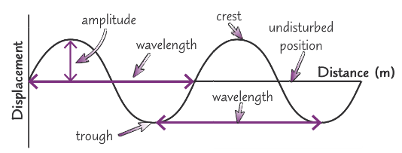
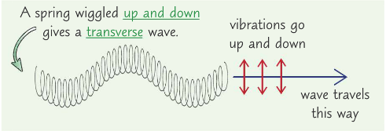
GCSE Knowledge Organiser Unit 1 – Waves
NUSA
SCIENCE
TWO
ONE
Transverse Wave | Longitudinal Wave
The oscillations (vibrations) are perpendicular (at 90°) to the direction of energy transfer | The oscillations (vibrations) are parallel to the direction of energy transfer.
Most waves are transverse, including all electromagnetic (EM) waves e.g. light, ripples and waves in water and waves on a string | An example is sound waves in air
Keyword | Definition
Amplitude | The maximum displacement of a point on the wave from its undisturbed position
Wavelength | The distance between the same point on two adjacent waves
Frequency | The number of complete waves passing a certain point per second. It is measured in Hertz (Hz)
Wave speed | The speed at which the energy is transferred (or the wave moves) through the medium
THREE
Speed of sound in air = 330 m/s
FOUR
Electromagnetic (EM) waves are transverse waves
They transfer energy from a source to an absorber
All EM waves travel at the same speed through air or a vacuum (space)
They are vibrations of electric and magnetic fields (not particles)
EM waves travel at different speeds in different materials (which can lead to refraction)
We group EM waves based on their frequency and wavelength (see the spectrum above)
Our eyes can only detect a small section of the EM waves – visible light
EM waves are generated by different changes in the atoms of their nuclei
When a wave meets a boundary between two materials, three things can happen:
Absorption | The wave transfers energy to the material’s energy stores (often thermal energy store = heating)
Transmission | The wave carries on travelling through the new material. This leads to refraction.
Reflection | The incoming ray is neither absorbed or transmitted, it is ‘sent back’ away from the second material

Slide 2
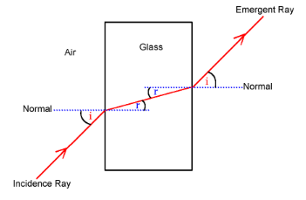
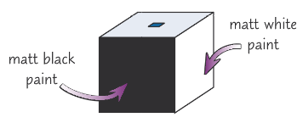
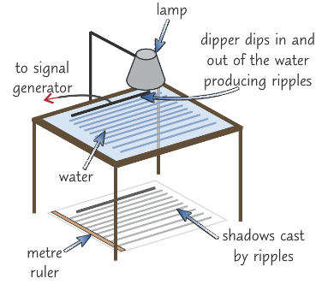
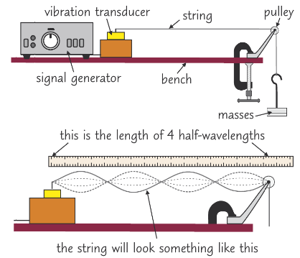
GCSE Knowledge Organiser Unit 1 – Waves
NUSA
SCIENCE
FIVE
Refraction
When a wave crosses a boundary of a different material, it changes speed
If the wave is travelling along the normal it will change speed but is not refracted
If the wave hits the boundary at an angle it changes direction, it is refracted
As the wave travels into the second material, it slows down and bends towards the normal
As the wave leaves the material, it speeds up and bends away from the normal
The higher the density of material, the more the wave is refracted (the more the wave slows down)
The wavelength of the wave changes when it is refracted, but the frequency stays the same
SIX
Refraction
SEVEN
EM Wave | Uses | Dangers
Radio waves | Television, radio, radio telescopes | Isn’t absorbed by the soft tissue – passes through without damage
Microwaves | Satellite communications, cooking food | Burns and damage to eyes
Infrared | Electric heaters, cooking food, infrared cameras | Burns
Visible light | Fibre optic communications | Damage to eyes
Ultraviolet | Fluorescent lamps, sun tanning | Damage surface cells (sunburn, premature ageing of skin), blindness and increased risk of skin cancer
X-rays | Medical imaging and treatments | Ionising radiation – causes gene mutation or cell destruction, and cancer
Gamma rays | Sterilising surgical instruments, treatment of cancer | Ionising radiation – causes gene mutation or cell destruction, and cancer
EIGHT
Required Practicals
Leslie Cube – Infrared emission
Ripple tank – waves in a liquid
(calculate the speed of waves)
A Leslie cube is a hollow, watertight, metal cube made of e.g. aluminium, whose four vertical faces have different surfaces (e.g. matt black, shiny metal) – to investigate IR emission
Waves on a string (solid)
(calculate the speed of waves)

