Slide 1
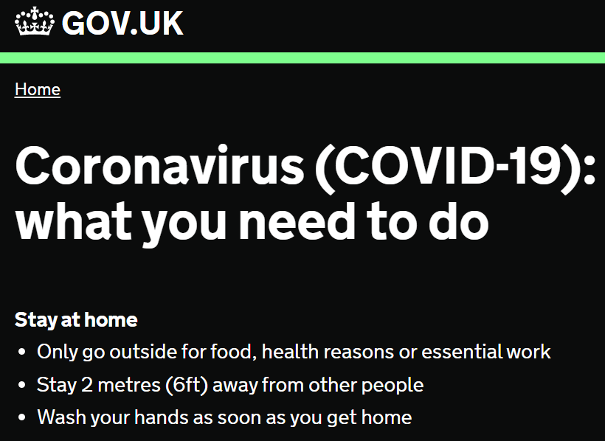
P.D- Attitude to learning at nusa.
March 2020
*You must present this to your household! Email Miss Malhi for a green flag- with a picture of you presenting!

Slide 2
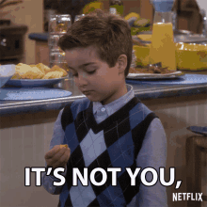
Attitude to Learning at NUSA
The time has come for NUSA pupils to step up!
We had no idea we would have to social distance!
We can be really creative in this time, learn from each other but in a different way!
What are we going to do about it?
We are going to stick together!
Home learning has to be fun- make it so!!
Don’t go out- wash your hands, keep a distance. The quicker we do this, the quicker we can save more lives. You got this!

Slide 3
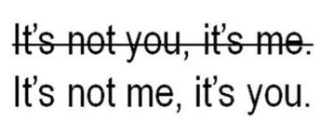
Attitude to Learning at NUSA
The time has come for NUSA pupils to step up!
Currently, during this pandemic, we have an opportunity to develop our own love of learning.
What are we going to do about it?
Teachers will plan their lessons, as usual.
Pupils must ensure they have their equipment and their mind ready, for learning.
Pupils need to make sure they are working as hard as their teacher.
How are we going to do this?

Slide 4
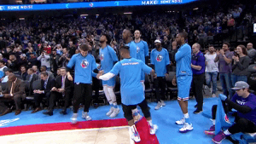
Attitude to Learning (ATL) at NUSA
Pupils need to reflect on their own learning.
4 ways for you to get a better ATL score: (I am...)
Willing to learn (two weeks ago)
Resilient (this week)
Self-motivated (last week)
Determined
Each week in Tutor Time PD, we will look at a category at a time, celebrating success! So you can be as happy to step into a ‘classroom’ as this!

Slide 5
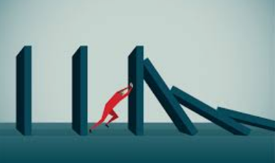
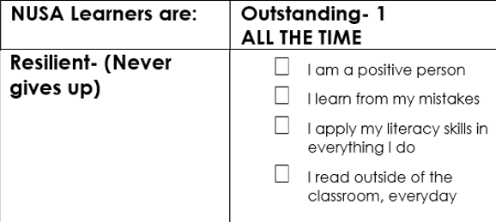
Attitude to Learning at NUSA
2) Resilient
Ask yourself, do you keep trying every day?
Is there anyone in the class that believes they are a 1 (outstanding) every lesson?
How can you become outstanding?

Slide 6
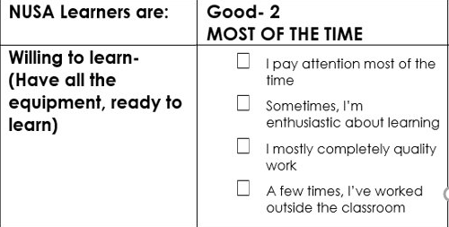
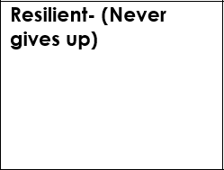
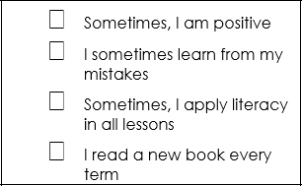
Attitude to Learning at NUSA
2) Resilient
Ask yourself, are you positive every day?
What makes you happy to try again?
How many of you would say you are a 2 or 'good'? Is that enough for you?
There are so many online book now available for free- check it out!

Slide 7
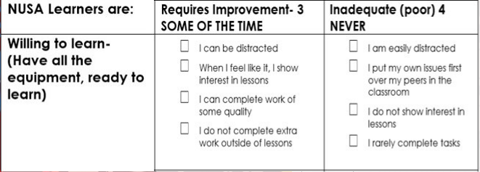
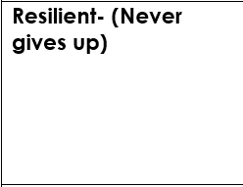
Attitude to Learning at NUSA
2) Resilient
Who gets in a mood? You cannot be successful with this attitude #FactsOnly
How many of you would say you are a 3/ 4, 'requiring improvement' or 'inadequate'?
How many of you are like this???

Slide 8
Attitude to Learning at NUSA
https://www.youtube.com/watch?v=bQxqIKTO2Ck
What is your opinion of this video? What is he saying? Discuss with who you are living with!
How many of you would give up after that feedback? You must be resilient; it will make you successful in every stage of your life. #FactsOnlyVibes #StayAtHome

Slide 9
Attitude to Learning at NUSA
What is your opinion of this video? What is he saying? Discuss with who you are living with!
#StayAtHome
#ProtectOurNHS
#HomeLearningVibes

Slide 10
Empowered pupils will make history!
You must be positive
Reflect and think about how you can improve, every day.
You've got this! Until next week!

