Slide 1
P.D- Attitude to learning at nusa.
March 2020
*Tutor- this must be delivered by a tutee. Green flag and points for the presenter!

Slide 2
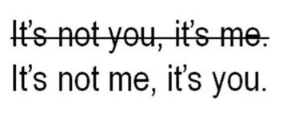
Attitude to Learning at NUSA
The time has come for NUSA pupils to step up!
Currently, standards are not where they are expected to be. Also, too many pupils are asking to go to the toilet. You are only allowed at break/lunchtimes.
What are we going to do about it?
Teachers will plan their lessons, as usual.
Pupils must ensure they have their equipment and their mind ready, for learning, without asking to leave.
Pupils need to make sure they are working as hard as their teacher.
How are we going to do this?

Slide 3
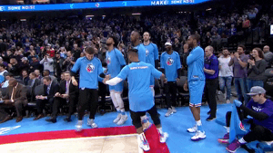
Attitude to Learning (ATL) at NUSA
Pupils need to reflect on their own learning.
4 ways for you to get a better ATL score: (I am...)
Willing to learn (last week)
Resilient (next week)
Self-motivated (this week!)
Determined
Each week in Tutor Time PD, we will look at a category at a time, celebrating success! So you can be as happy to step into a classroom as this!
*P.S- smashed it last week with your presenting, I saw you! Megan, Roisin, Joseph, Evie-Mae, Sophie, Amy- all of you presenters!

Slide 4
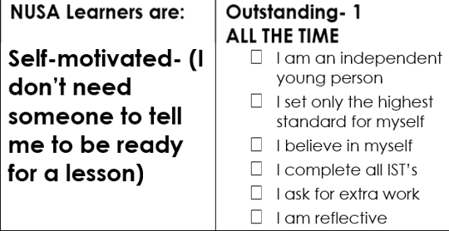
Attitude to Learning at NUSA
3) Self-motivated
Ask yourself, how much do you do for yourself?
Is there anyone in the class that believes they are a 1 (outstanding) every lesson?
How can you become outstanding?

Slide 5
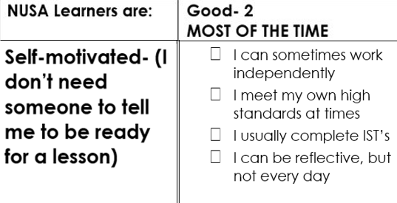
Attitude to Learning at NUSA
3) Self-motivated
Ask yourself, are you independent every day?
How do you set standards for yourself? Maybe you should start right now!
How many of you would say you are a 2 or 'good'? Is that enough for you??

Slide 6
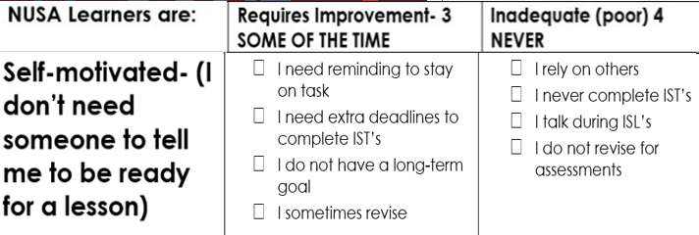
Attitude to Learning at NUSA
3) Self-motivated
Who is this? You cannot be successful with this attitude #FactsOnly
How many of you would say you are a 3/ 4, 'requiring improvement' or 'inadequate'?

Slide 7
Attitude to Learning at NUSA
Watch the clip- just press play on the picture
Why should you keep trying? What is the point?
Should you give up on yourself? You’re not even 16 yet, can you give up on yourself already? You must be self-determined; it will make you successful in every stage of your life. #BelievingVibes

Slide 8
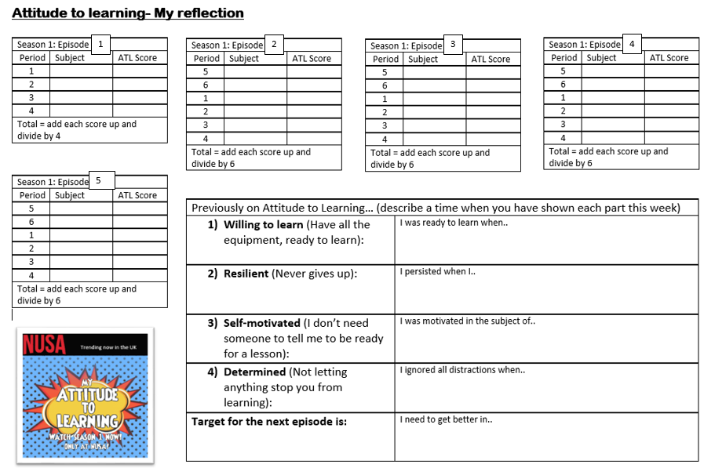
Empowered pupils will make history!
You must be positive
Reflect and think about how you can improve, every day. Use the sheet and give yourself a score, for each lesson in Tutor Time. This will become a ‘Do Now’ task every tutor time.
*Tutor- Nominate someone to hand them out every day at the beginning. Should be completed in silence. Green flag and points please!

Slide 9
Empowered pupils will make history!
You've got this! Until next week!

