Slide 1
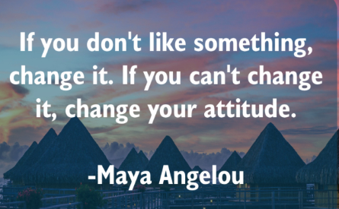
P.D- Attitude to learning at nusa.
March 2020
*Tutor- this must be delivered by a tutee. Green flag for the presenter!

Slide 2
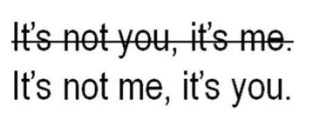
Attitude to Learning at NUSA
The time has come for NUSA pupils to step up!
Currently, standards are not where they are expected to be. Also, too many pupils are asking to go to the toilet. You are only allowed at break/lunchtimes.
What are we going to do about it?
Teachers will plan their lessons, as usual.
Pupils must ensure they have their equipment and their mind ready, for learning, without asking to leave.
Pupils need to make sure they are working as hard as their teacher.
How are we going to do this?

Slide 3
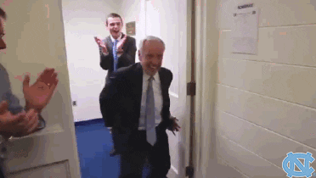
Attitude to Learning (ATL) at NUSA
Pupils need to reflect on their own learning.
4 ways for you to get a better ATL score: (I am...)
Willing to learn
Resilient
Self-motivated
Determined
Each week in Tutor Time PD, we will look at a category at a time, celebrating success! So you can be as happy to step into a classroom as this!

Slide 4
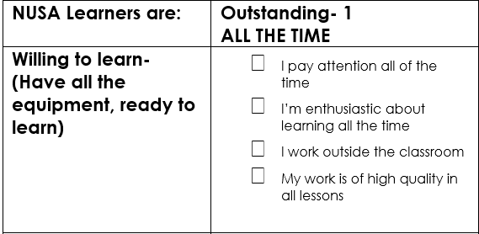
Attitude to Learning at NUSA
1) Willing to learn
Ask yourself, are you willing to be better every day?
Is there anyone in the class that believes they are a 1 (outstanding) every lesson?
How can you become outstanding?

Slide 5
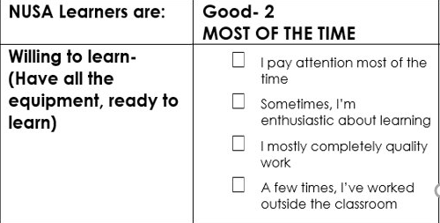
Attitude to Learning at NUSA
1) Willing to learn
Ask yourself, are you willing to be better every day?
What makes you enthusiastic about learning?
How many of you would say you are a 2 or 'good'? Is that enough for you?

Slide 6
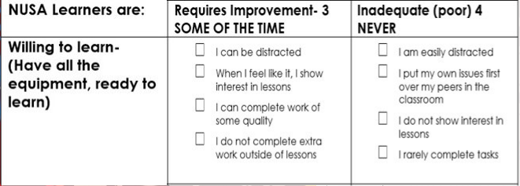
Attitude to Learning at NUSA
1) Willing to learn
Who is more like this? You cannot be successful with this attitude #FactsOnly
How many of you would say you are a 3/ 4, 'requiring improvement' or 'inadequate'?

Slide 7
Attitude to Learning at NUSA
https://supernetball.com.au/video/kelsey-browne-and-rob-wright-exchange
What is your opinion on this video? Savage or not?
How many of you would give up after that feedback? You must be willing to learn; it will make you successful in every stage of your life. #FactsOnlyVibes

Slide 8
Empowered pupils will make history!
You must be positive
Reflect and think about how you can improve, every day.
You've got this! Until next week!

